Slide 1


Unit – 3
Linear Transformation
B.Tech. $→$1st Semester
Mathematics – I (2601HS101)
Course Outcome:
explain linear transformation concepts with examples using change of basis and matrix representation techniques.

Slide 2

Topics of Unit 3
  Linear Transformations
  Kernel, Range and Rank-Nullity Theorem
  Matrix Representation of Linear Transformations
  Change of Basis
  Similarity of Matrices
Looping

Slide 3

Outline of Unit 3
  Linear Transformations
  Kernel, Range and Rank-Nullity Theorem
  Matrix Representation of Linear Transformations
  Change of Basis
  Similarity of Matrices
Looping

Slide 4
Method-1
Linear Transformations

Slide 5
Introduction
Linear Transformation is a mapping between vector spaces that preserves vector addition and scalar multiplication.
Linear transformations can be represented using matrices, which simplify computations and analysis.
The kernel, range, and Rank–Nullity Theorem help us to understand the properties of a linear transformation.
Different matrix representations of the same transformation can be obtained by changing the basis, leading to the concept of similar matrices.
Linear transformations have important applications in Artificial Intelligence, Machine Learning, computer graphics, image processing, and data analysis.

Slide 6
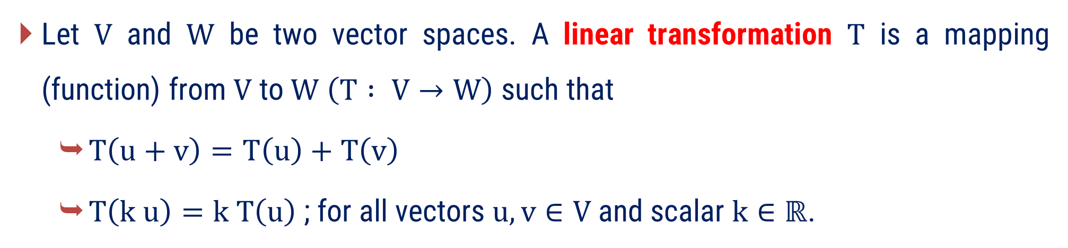
Linear Transformation
Let $V$ and $W$ be two vector spaces. A linear transformation $T$ is a mapping (function) from $V$ to $W$ $\left(T : V→W\right)$ such that
  $T\left(u+v\right)=T\left(u\right)+T\left(v\right)$
  $T\left(k u\right)=k T\left(u\right)$ ; for all vectors $u, v∈V$ and scalar $k∈ℝ$.

Slide 7
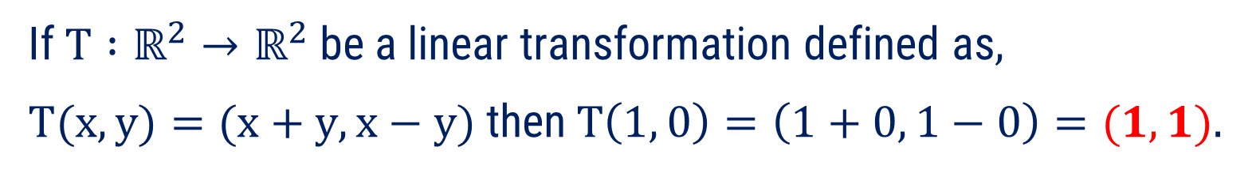
Linear Transformation
If $T∶V→W$ be a linear transformation and $u∈V,$ then $T(u)$ is called the image of $u$ under $T$.
Example:
If $T∶ℝ^{2}→ℝ^{2}$ be a linear transformation defined as,
$T(x, y)=(x+y, x−y)$ then$T\left(1, 0\right)=\left(1+0, 1−0\right)=(1, 1)$.
So, $(1, 1)$ is image of element $(1, 0)$ under the transformation T.
If $V=W$, then the linear transformation $T : V→V$ is called linear operator.

Slide 8
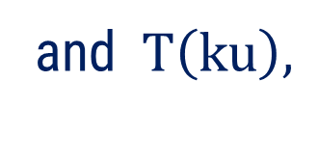



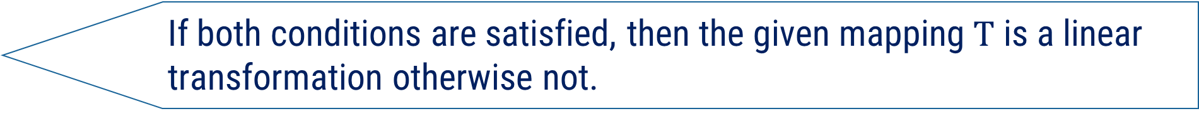
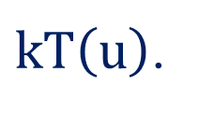
Procedure to Check Mapping T is a Linear Transformation or Not
Let $T :V→W$ be any mapping.
1
Select two elements $u$ and $v$ from $V$ and one scalar $k∈ℝ$.
2
Find $T\left(u+v\right),$
$$T\left(u\right)+ T\left(v\right)$$
and $T\left(ku\right),$
$kT\left(u\right)$.
Verify $T\left(u+v\right)= T\left(u\right)+ T\left(v\right)$ and $T\left(ku\right)= kT\left(u\right)$.
3
4
If both conditions are satisfied, then the given mapping $T$ is a linear transformation otherwise not.

Slide 9
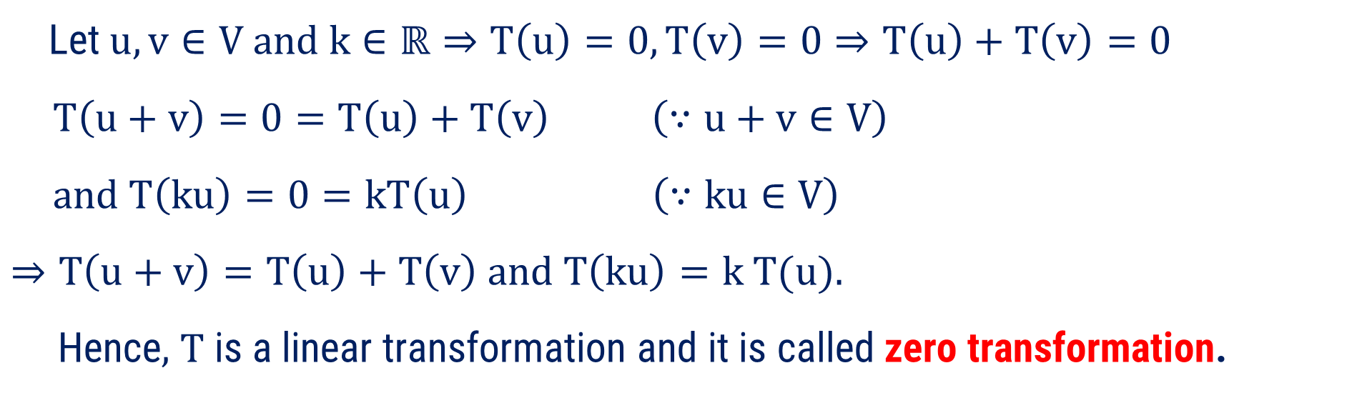
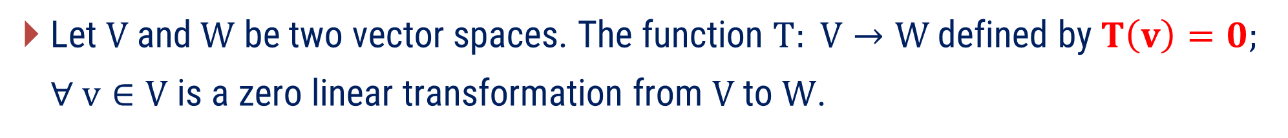
Some Standard Linear Transformations
1) Zero Transformation
Let $V$ and $W$ be two vector spaces. The function $T: V→W$defined by $T\left(v\right)=0;$
$∀ v∈V$ is a zero linear transformation from $V$ to $W$.
Proof:
Let $u, v∈V and k∈ℝ⇒T\left(u\right)=0, T\left(v\right)=0⇒T\left(u\right)+T\left(v\right)=0$
$$T\left(u+v\right)=0=T\left(u\right)+T\left(v\right) \left(∵u+v∈V\right)$$
$$and T\left(ku\right)=0=kT\left(u\right) \left(∵ku∈V\right)$$
$⇒T\left(u+v\right)=T\left(u\right)+T\left(v\right) and T\left(ku\right)=k T(u)$.
Hence, T is a linear transformation and it is called zero transformation.

Slide 10
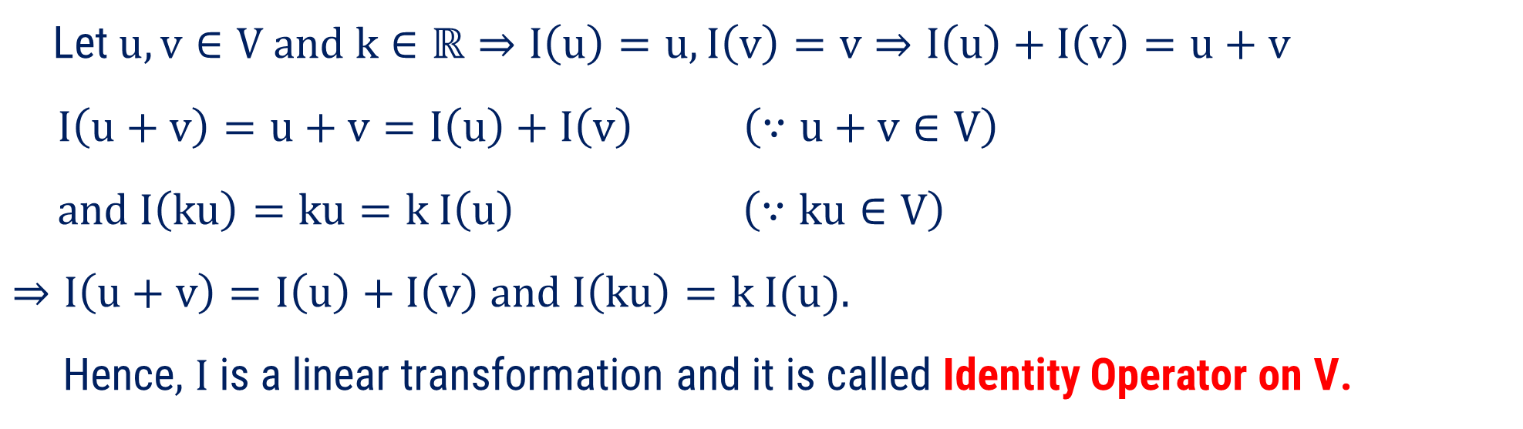

Some Standard Linear Transformations
2) Identity Operator
Let $V$ be a vector space. The function $I: V→V$defined by $I\left(v\right)=v ;∀ v∈V$ is a identity linear operator from $V$ to $V$.
Proof :
Let $u, v∈V and k∈ℝ⇒I\left(u\right)=u, I\left(v\right)=v⇒I\left(u\right)+I\left(v\right)=u+v$
$$I\left(u+v\right)=u+v=I\left(u\right)+I\left(v\right) \left(∵u+v∈V\right)$$
$$and I\left(ku\right)=ku=k I\left(u\right) \left(∵ku∈V\right)$$
$⇒I\left(u+v\right)=I\left(u\right)+I\left(v\right) and I\left(ku\right)=k I(u)$.
Hence, I is a linear transformation and it is called Identity Operator on V.

Slide 11
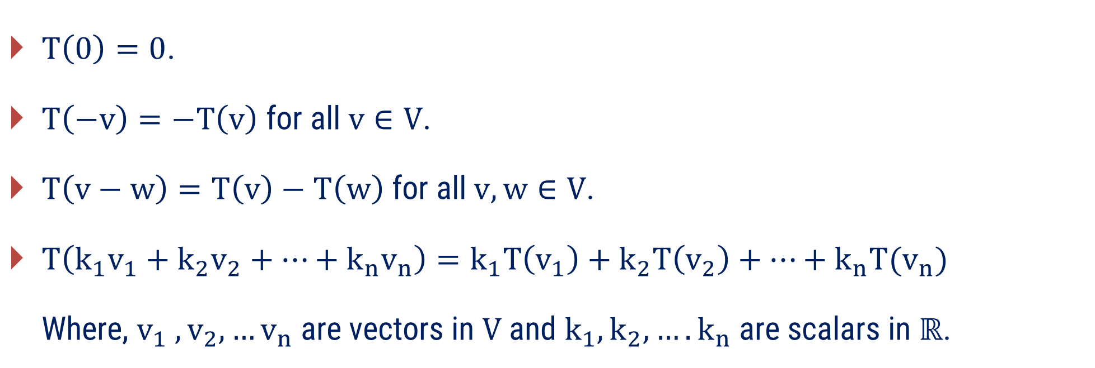
Properties of Linear Transformations
If $T :V→W$ is a linear transformation, then
$T\left(0\right)=0$.
$T\left(−v\right)=−T\left(v\right)$ for all $v∈V$.
$T\left(v−w\right)=T\left(v\right)−T\left(w\right) \text{for} \text{all} v, w∈V\text{.}$
$T\left(k_{1}v_{1}+k_{2}v_{2}+…+k_{n}v_{n}\right)=k_{1}T\left(v_{1}\right)+k_{2}T\left(v_{2}\right)+…+k_{n}{T(v}_{n})$
Where, $v_{1} , v_{2},…v_{n}$are vectors in $V$ and $k_{1}, k_{2},…. k_{n}$ are scalars in $ℝ$.

Slide 12
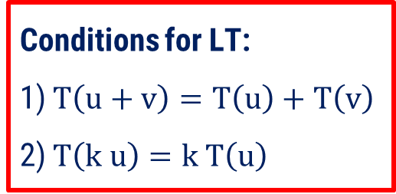



Method:1 $⇝$ Example:1
Example
Show that the following functions are linear transformations.
$\left(i\right) T∶ℝ^{2}→ℝ^{2} ; T(x, y)=(x+3y, 3x−y)$.
Solution
Let $u=\left(x_{1},y_{1}\right), v=\left(x_{2},y_{2}\right)$be the vectors in $ℝ^{2}$ and $k∈ℝ$.
Now, $T\left(u+v\right) =T(\left(x_{1},y_{1}\right)+\left(x_{2},y_{2}\right))$
$$=T(x_{1}+x_{2},y_{1}+y_{2})$$
$$=(\left(x_{1}+x_{2}\right)+3\left(y_{1}+y_{2}\right), 3\left(x_{1}+x_{2}\right)−\left(y_{1}+y_{2}\right))$$
  Conditions for LT:
  1) $T\left(u+v\right)=T\left(u\right)+T\left(v\right)$
  2) $T\left(k u\right)=k T\left(u\right)$
$=(x_{1}+x_{2}+3y_{1}+3y_{2},3x_{1}+3x_{2}−y_{1}−y_{2})$ ……..(1)

Slide 13







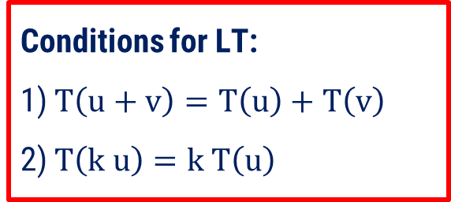
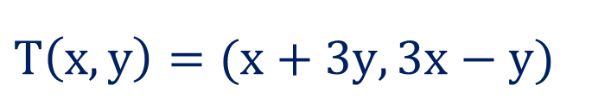
Method:1 $⇝$ Example:1(Continue)
$$\text{Now}, T\left(u\right)=T(x_{1},y_{1})$$
  Conditions for LT:
  1) $T\left(u+v\right)=T\left(u\right)+T\left(v\right)$
  2) $T\left(k u\right)=k T\left(u\right)$
$$=(x_{1}+3y_{1},3x_{1}−y_{1})$$
And $T\left(v\right)=T(x_{2},y_{2})$
$$=(x_{2}+3y_{2},3x_{2}−y_{2})$$
$$T\left(u\right)+T\left(v\right)$$
$$=\left(x_{1}+3y_{1},3x_{1}−y_{1}\right)+(x_{2}+3y_{2},3x_{2}−y_{2})$$
$$=\left(x_{1}+3y_{1}+x_{2}+3y_{2},3x_{1}−y_{1}+3x_{2}− y₂\right)$$
$=(x_{1}+x_{2}+3y_{1}+3y_{2},3x_{1}+3x_{2}−y_{1}−y_{2})$ ……..(2)
From (1) & (2) , $T\left(u+v\right)=T\left(u\right)+T\left(v\right)$
  $$T\left(x,y\right)=(x+3y,3x−y)$$
$T\left(u+v\right)=(x_{1}+x_{2}+3y_{1}+3y_{2},3x_{1}+3x_{2}−y_{1}−y_{2})$ ……..(1)

Slide 14


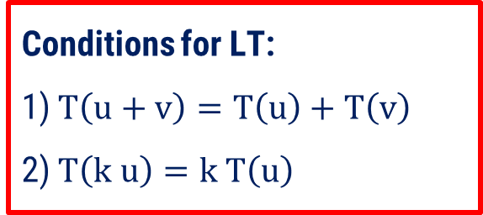
Method:1 $⇝$ Example:1(Continue)
Now, $ku=k\left(x_{1},y_{1}\right)=(kx_{1},ky_{1})$
  $$⇒T\left(ku\right)=T(kx_{1},ky_{1})$$
$$=(kx_{1}+3ky_{1},3kx_{1}−ky_{1})$$
  $$=k(x_{1}+3y_{1},3x_{1}−y_{1})$$
$$=k T(u)$$
Hence, T is a Linear Transformation.
  Conditions for LT:
  1) $T\left(u+v\right)=T\left(u\right)+T\left(v\right)$
  2) $T\left(k u\right)=k T\left(u\right)$
  $$T\left(x,y\right)=(x+3y,3x−y)$$

Slide 15
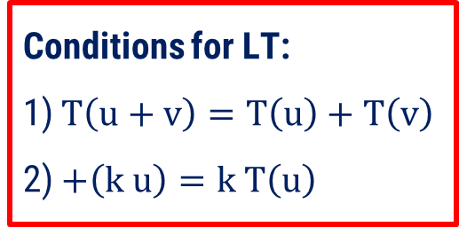



Method:1 $⇝$ Example:1(Continue)
Example
Show that the following functions are linear transformations.
$\left(ii\right) T∶ℝ^{2}→ℝ^{2} ; T(x, y)=(2x−y, x−y)$.
Solution
Let $u=\left(x_{1},y_{1}\right), v=\left(x_{2},y_{2}\right)$be the vectors in $ℝ^{2}$ and $k∈ℝ$.
Now, $T\left(u+v\right) =T(\left(x_{1},y_{1}\right)+\left(x_{2},y_{2}\right))$
$$=T(x_{1}+x_{2},y_{1}+y_{2})$$
$=(2\left(x_{1}+x_{2}\right)−\left(y_{1}+y_{2}\right), \left(x_{1}+x_{2}\right)−\left(y_{1}+y_{2}\right)$)
  Conditions for LT:
  1) $T\left(u+v\right)=T\left(u\right)+T\left(v\right)$
  2) $+\left(k u\right)=k T\left(u\right)$
$$=\left(2x_{1}+2x_{2}−y_{1}−y_{2}\right), (x_{1}+x_{2}−y_{1}− y₂)\text{……..}\text{(1)}$$

Slide 16


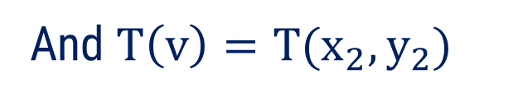




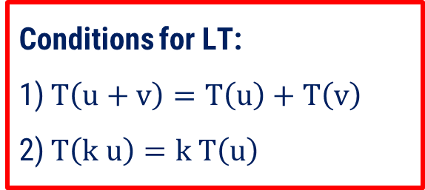
Method:1 $⇝$ Example:1(Continue)
$$\text{Now}\text{, }T\left(u\right)=T(x_{1},y_{1})$$
  Conditions for LT:
  1) $T\left(u+v\right)=T\left(u\right)+T\left(v\right)$
  2) $T\left(k u\right)=k T\left(u\right)$
$$=(2x_{1}−y_{1},x_{1}−y_{1})$$
And $T\left(v\right)=T(x_{2},y_{2})$
$$=(2x_{2}−y_{2},x_{2}−y_{2})$$
$$T\left(u\right)+T\left(v\right)$$
$$=\left(2x_{1}−y_{1},x_{1}−y_{1}\right)+(2x_{2}−y_{2},x_{2}−y_{2})$$
$$=\left(2x_{1}−y_{1}+2x_{2}−y_{2},x_{1}−y_{1}+x_{2}− y₂\right)$$
$$=\left(2x_{1}+2x_{2}−y_{1}−y_{2}\right), (x_{1}+x_{2}−y_{1}− y₂)\text{……..}\text{(}\text{2}\text{)}$$
From (1) & (2) , $T\left(u+v\right)=T\left(u\right)+T\left(v\right)$
$$T(x, y)=(2x−y, x−y)$$
$$T\left(u+v\right)=\left(2x_{1}+2x_{2}−y_{1}−y_{2}\right), (x_{1}+x_{2}−y_{1}− y₂)\text{……..}\text{(1)}$$

Slide 17


Method:1 $⇝$ Example:1(Continue)
Now, $ku=k\left(x_{1},y_{1}\right)=(kx_{1},ky_{1})$
  $$⇒T\left(ku\right)=T(kx_{1},ky_{1})$$
$$=(2kx_{1}−ky_{1},kx_{1}−ky_{1})$$
  $$=k(2x_{1}−y_{1},x_{1}−y_{1})$$
$$=k T(u)$$
Hence, T is a Linear Transformation.
  Conditions for LT:
  1) $T\left(u+v\right)=T\left(u\right)+T\left(v\right)$
  2) $T\left(k u\right)=k T\left(u\right)$
  $$T\left(x,y\right)=(2x−y,x−y)$$

Slide 18
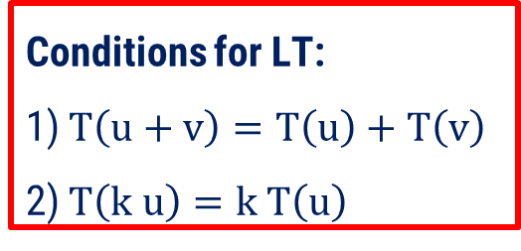
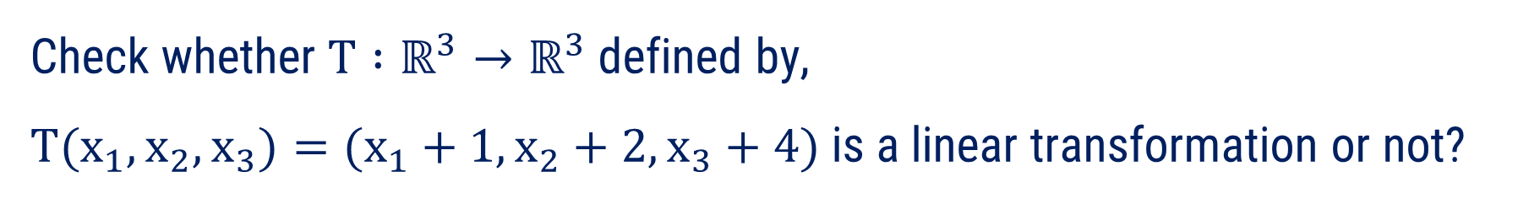


Method:1 $⇝$ Example:2
Check whether $T∶ℝ^{3}→ℝ^{3}$defined by,
$T(x_{1},x_{2},x_{3})=(x_{1}+1,x_{2}+2,x_{3}+4)$ is a linear transformation or not?
Example
Solution
Let $u=\left(x_{1},x_{2},x_{3}\right), v=\left(y_{1},y_{2},y_{3}\right)$be the vectors in $ℝ^{3}$ and $k∈ℝ$.
Now, $T\left(u+v\right) =T(\left(x_{1},x_{2},x_{3}\right)+\left(y_{1},y_{2},y_{3}\right))$
$$=T(x_{1}+y_{1},x_{2}+y_{2},x_{3}+y_{3})$$
$=\left(x_{1}+y_{1}+1,x_{2}+y_{2}+2,x_{3}+y_{3}+4\right)$……..(1)
  Conditions for LT:
  1) $T\left(u+v\right)=T\left(u\right)+T\left(v\right)$
  2) $T\left(k u\right)=k T\left(u\right)$

Slide 19





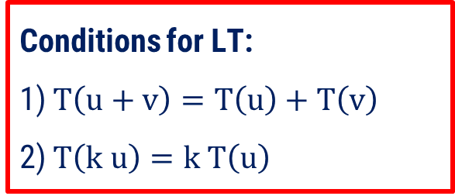

Method:1 $⇝$ Example:2(Continue)
Now,
$$T\left(u\right)=T(x_{1},x_{2},x_{3})$$
$$=(x_{1}+1, x_{2}+2,x_{3}+4)$$
$$\& T\left(v\right)=T(y_{1},y_{2},y_{3})$$
$$=(y_{1}+1, y_{2}+2,y_{3}+4)$$
$T\left(u\right)+T(v)$
$$=\left(x_{1}+1, x_{2}+2,x_{3}+4\right)+(y_{1}+1, y_{2}+2,y_{3}+4)$$
$=\left(x_{1}+y_{1}+2,x_{2}+y_{2}+4,x_{3}+y_{3}+8\right)$ ……..(2)
From (1) & (2) , $T\left(u+v\right)≠T\left(u\right)+T\left(v\right)$
  Conditions for LT:
  1) $T\left(u+v\right)=T\left(u\right)+T\left(v\right)$
  2) $T\left(k u\right)=k T\left(u\right)$
Hence, T is not a Linear Transformation.
$T\left(u+v\right)=\left(x_{1}+y_{1}+1,x_{2}+y_{2}+2,x_{3}+y_{3}+4\right)$……..(1)
$T(x_{1},x_{2},x_{3})=(x_{1}+1,x_{2}+2,x_{3}+4)$

Slide 20
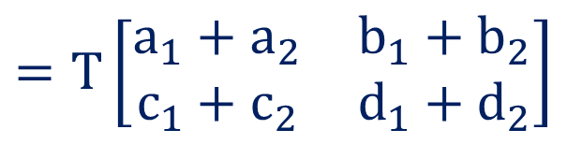
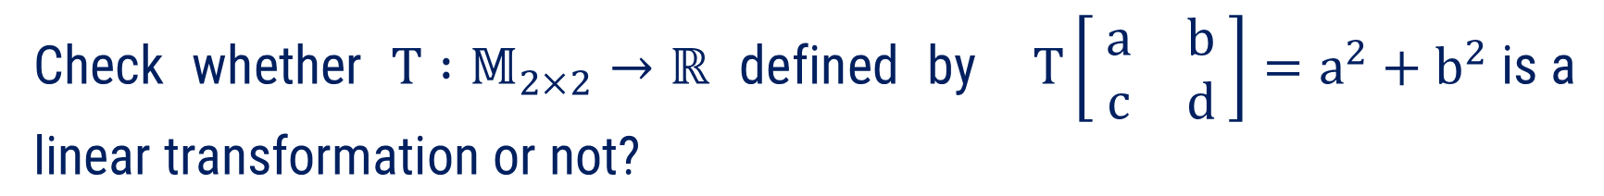

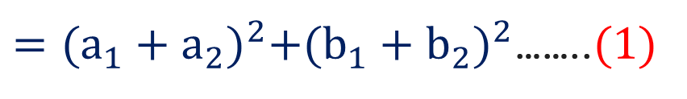

Method:1 $⇝$ Example:3
Check whether $T∶𝕄_{2×2}→ℝ$ defined by $T\left[ \begin{matrix}a & b \\ c & d\end{matrix} \right]=a^{2}+b^{2} \text{is} \text{a} \text{linear} \text{transformation} \text{or} \text{not}\text{?}$
Example
Solution
Let $A=\left[ \begin{matrix}a_{1} & b_{1} \\ c_{1} & d_{1}\end{matrix} \right],B=\left[\begin{matrix}a_{2} & b_{2} \\ c_{2} & d_{2}\end{matrix}\right]$ be two matrices in $𝕄_{2×2}$and $k∈ℝ$.
Now, $T\left(A+B\right) =T\left\{ \left[ \begin{matrix}a_{1} & b_{1} \\ c_{1} & d_{1}\end{matrix} \right]+\left[\begin{matrix}a_{2} & b_{2} \\ c_{2} & d_{2}\end{matrix}\right] \right\}$
$$=T\left[\begin{matrix}a_{1}+a_{2} & b_{1}+b_{2} \\ c_{1}+c_{2} & d_{1}+d_{2}\end{matrix}\right]$$
  Conditions for LT:
  1) $T\left(u+v\right)=T\left(u\right)+T\left(v\right)$
  2) $T\left(k u\right)=k T\left(u\right)$
$={(a_{1}+a_{2})}^{2}+{(b_{1}+b_{2})}^{2}$……..$(1)$

Slide 21

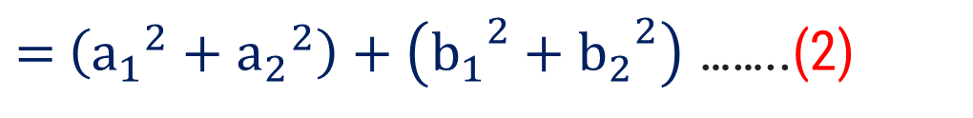
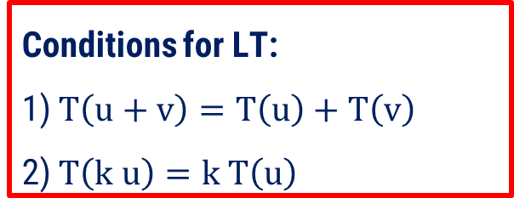







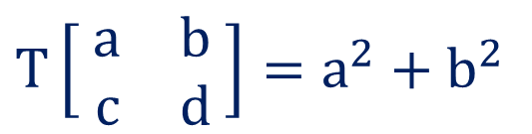
Method:1 $⇝$ Example:3(Continue)
Now, $T\left(A\right) =T\left[ \begin{matrix}a_{1} & b_{1} \\ c_{1} & d_{1}\end{matrix} \right]$
$$={a_{1}}^{2}+{b_{1}}^{2}$$
& $T\left(B\right) =T\left[ \begin{matrix}a_{2} & b_{2} \\ c_{2} & d_{2}\end{matrix} \right]$
$$={a_{2}}^{2}+{b_{2}}^{2}$$
$T\left(A\right)+T(B)$
$=$ $\left({a_{1}}^{2}+{b_{1}}^{2}\right)+\left({a_{2}}^{2}+{b_{2}}^{2}\right)$
$=$ $\left({a_{1}}^{2}+{a_{2}}^{2}\right)+\left({b_{1}}^{2}+{b_{2}}^{2}\right)$ ……..(2)
From (1) & (2) , $T\left(A+B\right)≠T\left(A\right)+T\left(B\right)$
Hence, T is not a Linear Transformation.
  Conditions for LT:
  1) $T\left(u+v\right)=T\left(u\right)+T\left(v\right)$
  2) $T\left(k u\right)=k T\left(u\right)$
$$T\left[ \begin{matrix}a & b \\ c & d\end{matrix} \right]=a^{2}+b^{2}$$
$T\left(A+B\right)=$ ${(a_{1}+a_{2})}^{2}+{(b_{1}+b_{2})}^{2}$ ……..(1)

Slide 22


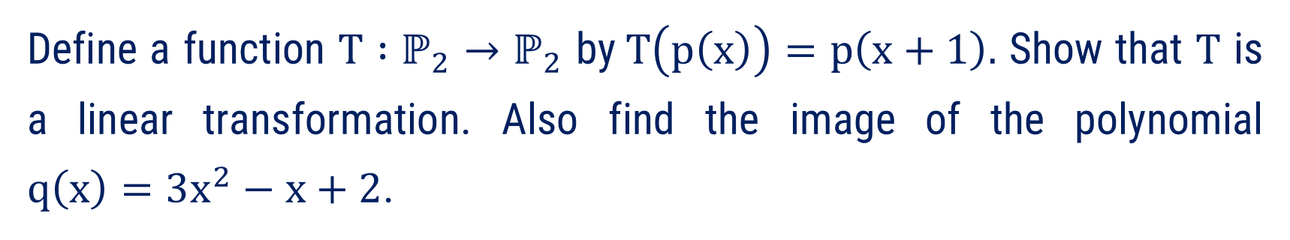


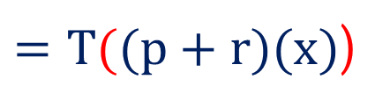





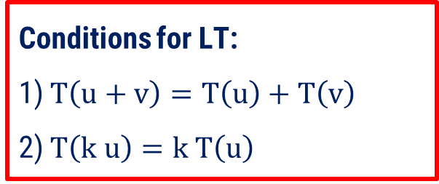
Method:1 $⇝$ Example:4
Define a function $T∶ℙ_{2}→ℙ_{2}$ by$T\left(p\left(x\right)\right)=p\left(x+1\right).$ Show that $T$ is a linear transformation. Also find the image of the polynomial
$q\left(x\right)=3x^{2}−x+2$.
Example
Solution
Let $p\left(x\right),r\left(x\right)$ be the two polynomials in $ℙ_{2}$and $k∈ℝ$.
$$T\left(p\left(x\right)\right)$$
$$=p\left(x+1\right)$$
and $T\left(r\left(x\right)\right)$
$$=r\left(x+1\right)$$
Now, $T\left(p\left(x\right)+r\left(x\right)\right)$
$=T((p+r)(x)$)
$$=(p+r)(x+1)$$
  Conditions for LT:
  1) $T\left(u+v\right)=T\left(u\right)+T\left(v\right)$
  2) $T\left(k u\right)=k T\left(u\right)$
$$=p\left(x+1\right)+r(x+1)$$
$$= T(p\left(x\right))$$
$$+ T(r\left(x\right))$$

Slide 23



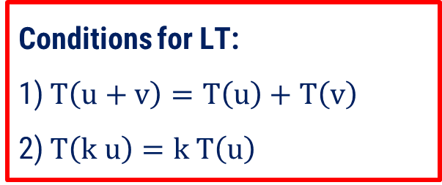



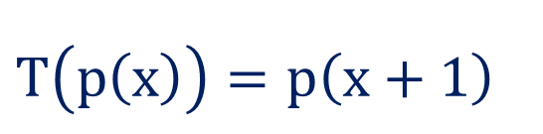

Method:1 $⇝$ Example:4(Continue)
  $$\text{Now}\text{, }T\left(kp(x)\right)$$
$$=(kp)(x+1)$$
$$=k p(x+1)$$
$$=k T(p\left(x\right))$$
Hence, T is a Linear Transformation.
$$T\left(q\left(x\right)\right)=q\left(x+1\right)$$
$$=3{\left(x+1\right)}^{2}−(x+1)+2$$
$$=3x^{2}+5x+4$$
  Conditions for LT:
  1) $T\left(u+v\right)=T\left(u\right)+T\left(v\right)$
  2) $T\left(k u\right)=k T\left(u\right)$
  $$T\left(p\left(x\right)\right)=p\left(x+1\right)$$

Slide 24
Method-2
Kernel, Range and Rank-Nullity Theorem

Slide 25
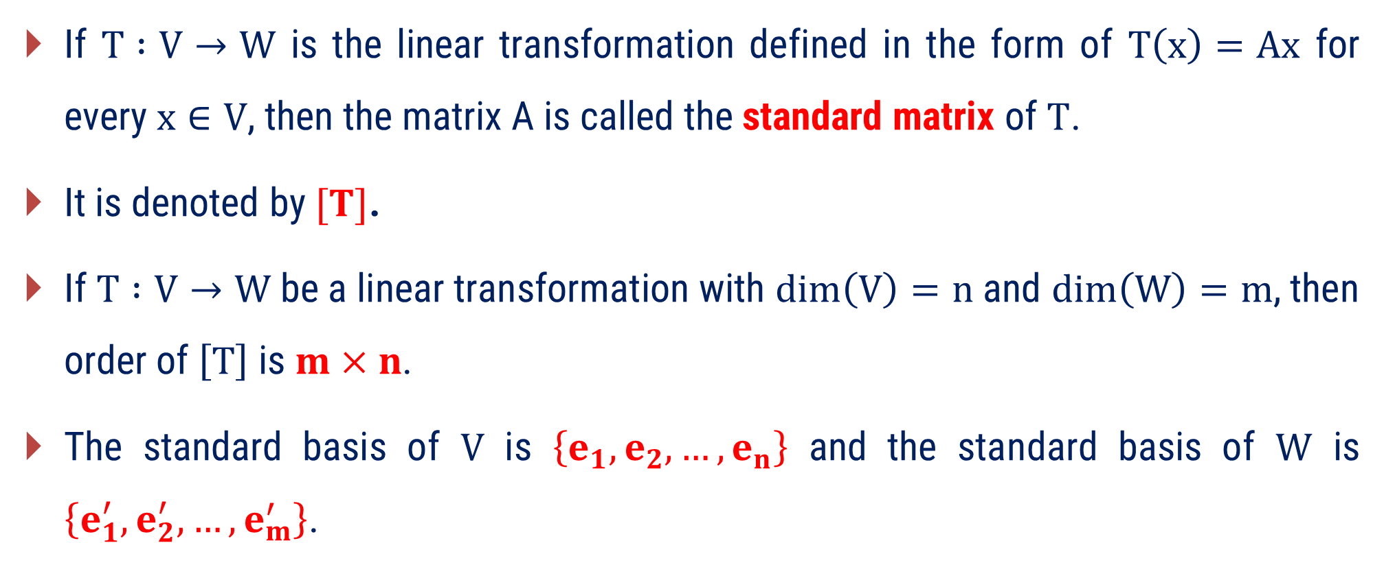
Standard Matrix of the Linear Transformation
If $T :V→W$ is the linear transformation defined in the form of $T\left(x\right)=Ax$ for every $x∈V$, then the matrix A is called the standard matrix of $T$.
It is denoted by $[T]$.
If $T :V→W$ be a linear transformation with $dim\left(V\right)=n$ and $dim\left(W\right)=m$, then order of $\left[T\right]$ is $m×n$.
The standard basis of $V$ is $\left\{e_{1}, e_{2}, …, e_{n}\right\}$ and the standard basis of $W$ is $\left\{e_{1}^{′}, e_{2}^{′}, …, e_{m}^{′}\right\}$.

Slide 26
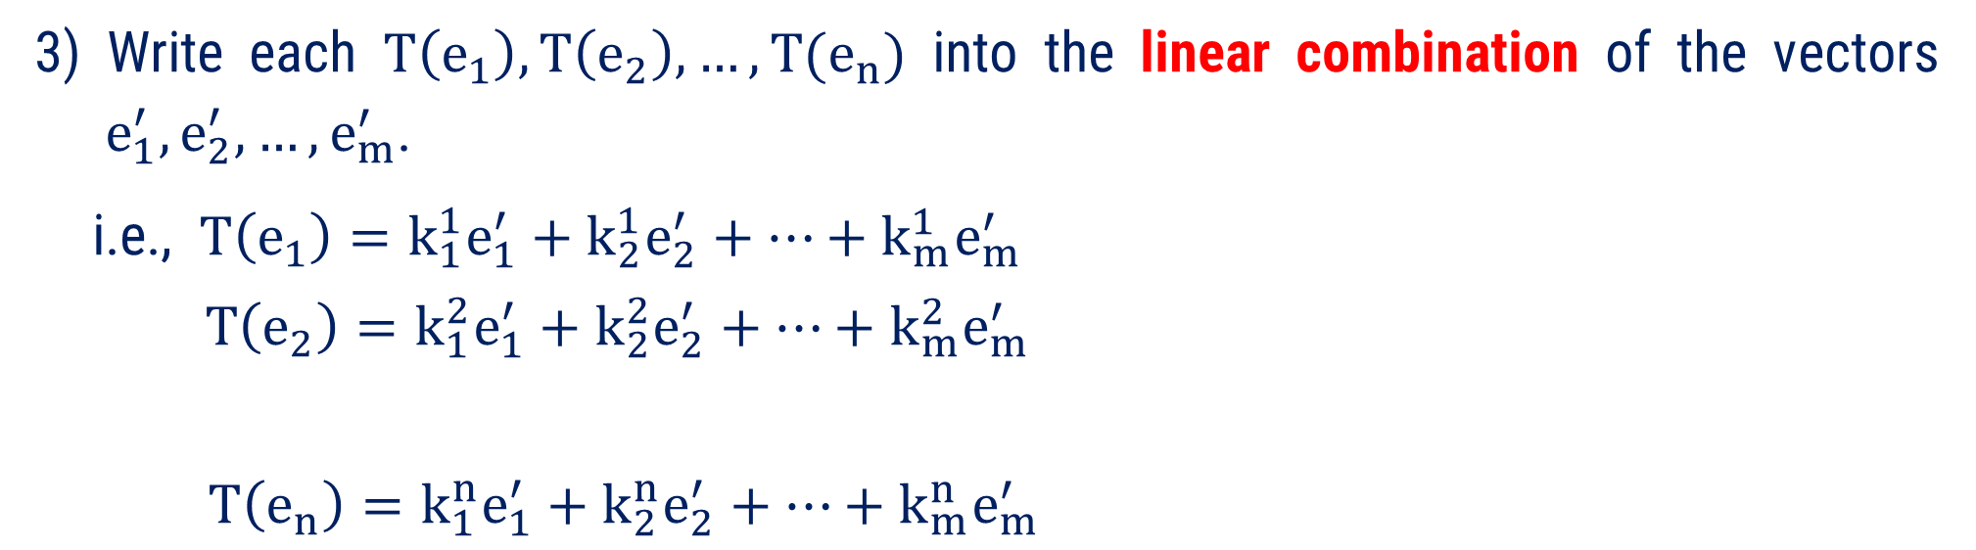
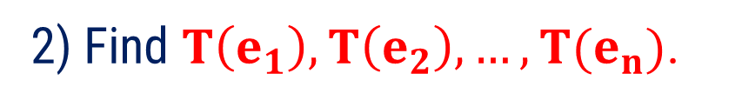
Procedure to Find the Standard Matrix $[T]$
1) Write the standard basis $\{e_{1},e_{2}, …, e_{n}\}$ of the domain $V$.
2) Find $T\left(e_{1}\right), T\left(e_{2}\right), …, T(e_{n})$.
3) Write each $T\left(e_{1}\right), T\left(e_{2}\right), …, T(e_{n})$ into the linear combination of the vectors
$e_{1}^{′}, e_{2}^{′}, …, e_{m}^{′}$.
i.e., $T\left(e_{1}\right)=k_{1}^{1}e_{1}^{′}+k_{2}^{1}e_{2}^{′}+…+k_{m}^{1}e_{m}^{′}$
$T\left(e_{2}\right)=k_{1}^{2}e_{1}^{′}+k_{2}^{2}e_{2}^{′}+…+k_{m}^{2}e_{m}^{′}$
$T\left(e_{n}\right)=k_{1}^{n}e_{1}^{′}+k_{2}^{n}e_{2}^{′}+…+k_{m}^{n}e_{m}^{′}$
...

Slide 27

Procedure to Find the Standard Matrix [T]
4) Write $k_{1}^{i}, k_{2}^{i}, …, k_{m}^{i}$ into the $i^{th}$ column of the matrix for each $i∈\left\{1, 2, …, n\right\}$.
5) The resulting matrix $\left[T\right]=\left[\begin{matrix}k_{1}^{1} & ⋯ & k_{1}^{n} \\ ⋮ & ⋱ & ⋮ \\ k_{m}^{1} & ⋯ & k_{m}^{n}\end{matrix}\right]$ is the standard matrix of $T$.

Slide 28
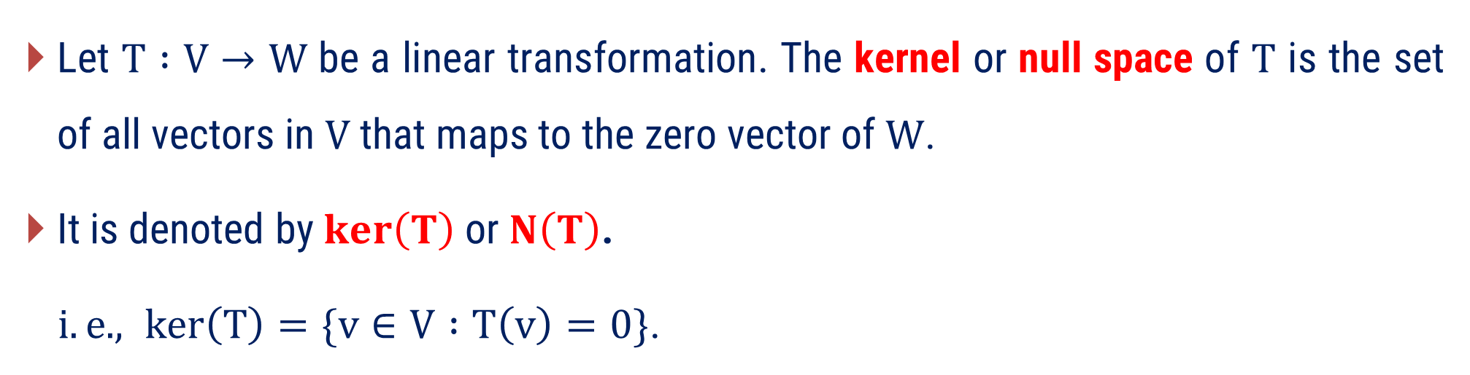
Kernel and Range
Kernel
Let $T :V→W$ be a linear transformation. The kernel or null space of $T$ is the set of all vectors in $V$ that maps to the zero vector of $W$.
It is denoted by $ker\left(T\right)$ or $N\left(T\right)$.
$i.e. , ker\left(T\right)=\{v∈V :T\left(v\right)=0\}$.

Slide 29
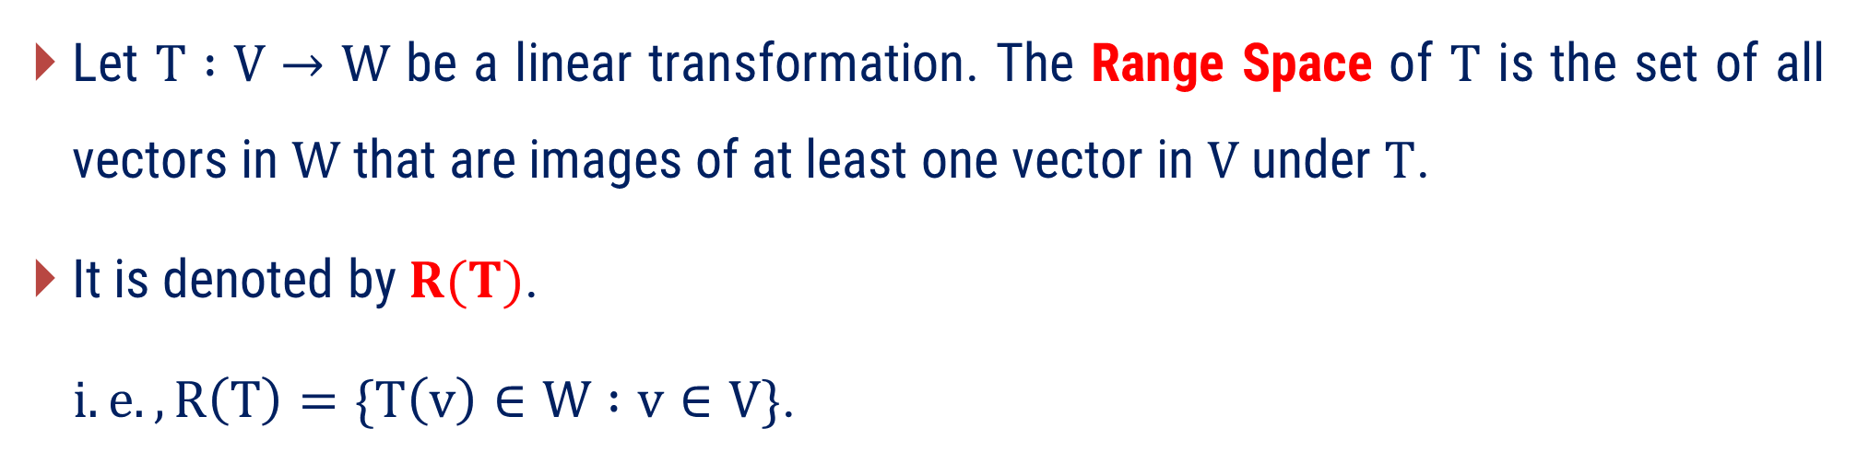
Kernel and Range
Range
Let $T :V→W$ be a linear transformation. The Range Space of $T$ is the set of all vectors in $W$ that are images of at least one vector in $V$ under $T$.
It is denoted by $R(T)$.
$i.e. ,R\left(T\right)=\{T\left(v\right)∈W :v∈V\}$.

Slide 30
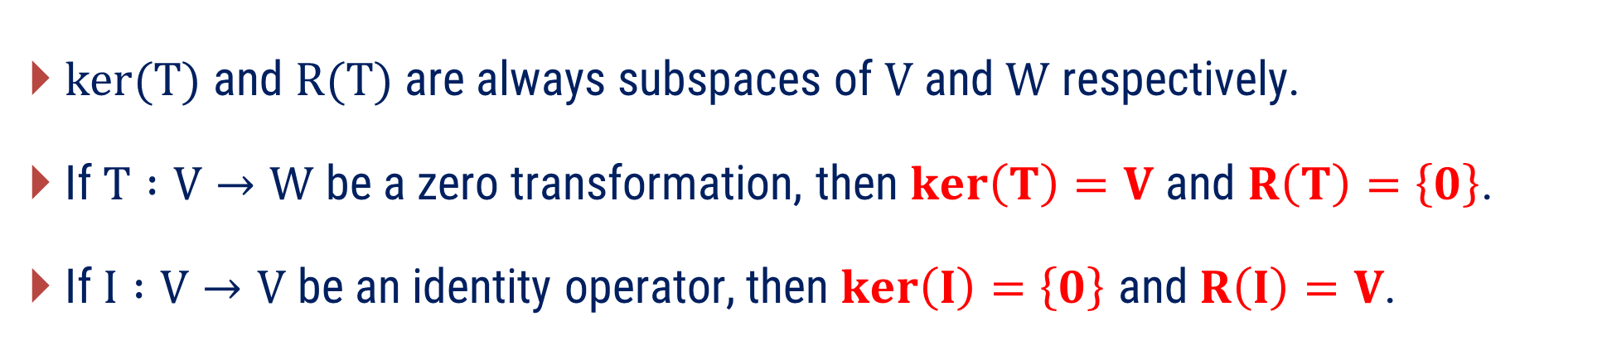
Remarks:
$ker(T)$ and $R(T)$ are always subspaces of $V$ and $W$ respectively.
If $T :V→W$ be a zero transformation, then $ker\left(T\right)=V$ and $R\left(T\right)=\left\{0\right\}$.
If $I :V→V$ be an identity operator, then $ker\left(I\right)=\left\{0\right\}$ and $R\left(I\right)=V$.

Slide 31
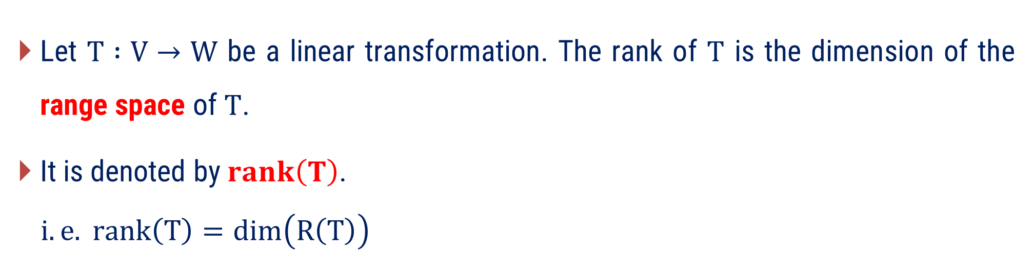
Rank and Nullity of Linear Transformation
Rank
Let $T :V→W$ be a linear transformation. The rank of $T$ is the dimension of the range space of $T$.
It is denoted by $rank\left(T\right)$.
$$i.e. rank\left(T\right)=\dim\left(R\left(T\right)\right)$$

Slide 32
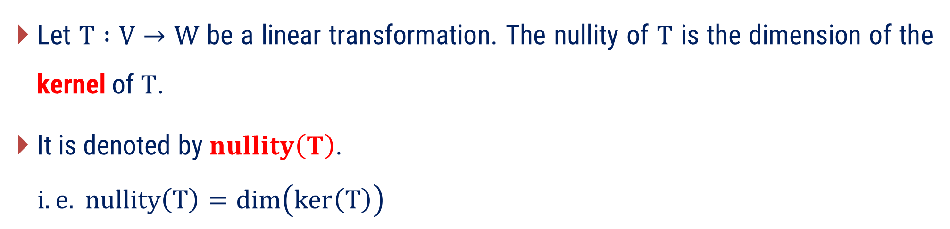
Rank and Nullity of Linear Transformation
Nullity
Let $T :V→W$ be a linear transformation. The nullity of $T$ is the dimension of the kernel of $T$.
It is denoted by $nullity\left(T\right)$.
$$i.e. nullity\left(T\right)=\dim\left(ker\left(T\right)\right)$$

Slide 33

Procedure to Find the Rank of T
Let $T :V→W$ be a Linear Transformation.
1
Find the standard matrix $[T]$ of given linear transformation.
2
Find the column space of standard matrix $[T]$.
Find the basis of column space which is also the basis of $R(T)$.
3
4
Number of elements in basis of $R\left(T\right)=\dim\left(R\left(T\right)\right)=rank\left(T\right)$.

Slide 34
Procedure to Find the Nullity of T
Let $T :V→W$ be a Linear Transformation.
1
Construct homogeneous system $T(u)=0$from the given linear transformation.
2
Find the solution of homogeneous system and write down the solution space.
Find the basis for $ker⁡(T)$ from the solution space.
3
4
Number of elements in basis of $ker\left(T\right)=\dim\left(ker\left(T\right)\right)=nullity(T)$.

Slide 35
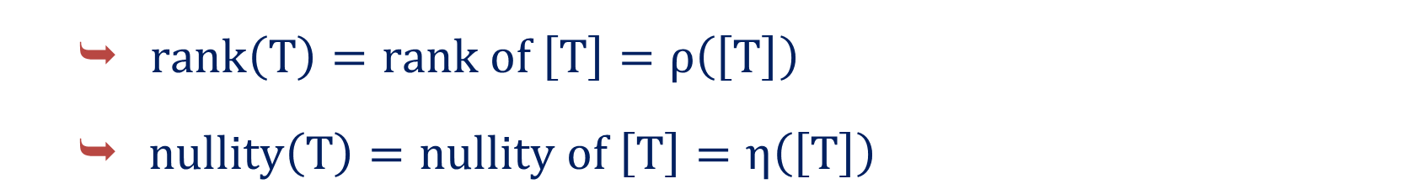
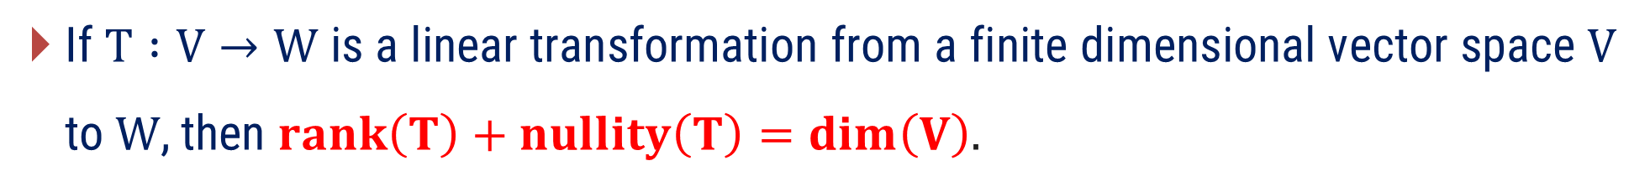
Rank-Nullity Theorem
If $T :V→W$ is a linear transformation from a finite dimensional vector space $V$ to $W$, then $rank\left(T\right)+nullity\left(T\right)=dim\left(V\right).$
Remarks:
  $rank\left(T\right)=rank of \left[T\right]=ρ\left(\left[T\right]\right)$
  $nullity\left(T\right)=nullity of \left[T\right]=η\left(\left[T\right]\right)$

Slide 36


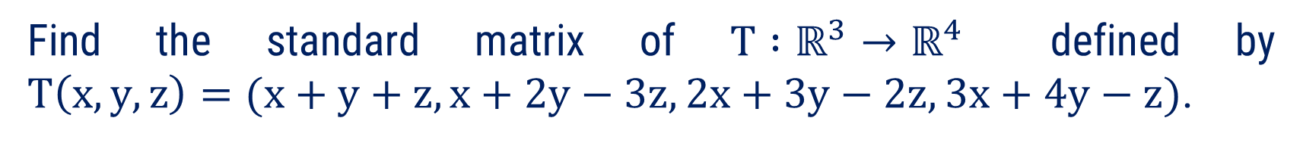










Method:2 $⇝$ Example:1
Example
Find the standard matrix of $T∶ℝ^{3}→ℝ^{4}$ defined by
$T\left(x, y, z\right)=(x+y+z, x+2y−3z, 2x+3y−2z, 3x+4y−z)$.
Solution
Standard basis of $ℝ^{3}$:
$e_{1}=\left(1, 0, 0\right),$ $e_{2}=\left(0, 1, 0\right), e_{3}=\left(0, 0, 1\right)$
$$T\left(e_{1}\right)=T\left(1, 0, 0\right)$$
$$=(1+0+0, 1+2\left(0\right)−3\left(0\right),2(1)+3\left(0\right)−2\left(0\right),3(1)+4\left(0\right)−0)$$
$$=(1, 1, 2, 3)$$
The standard matrix is
$$1$$
$$1$$
$$2$$
$$3$$
$$1$$
$$2$$
$$3$$
$$4$$
$$1$$
$$−3$$
$$−2$$
$$−1$$
$$T\left(e_{2}\right)=T\left(0,1,0\right)$$
$$=(1, 2, 3, 4)$$
$$T\left(e_{3}\right)=T\left(0,0,1\right)$$
$$[T]=$$
$$=(1, −3, −2, −1)$$
$$4×3$$

Slide 37



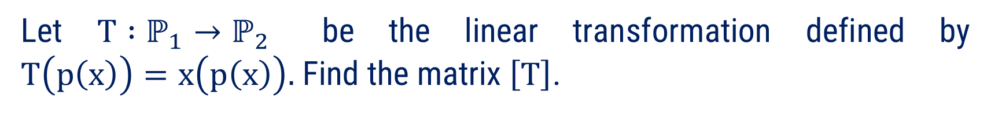
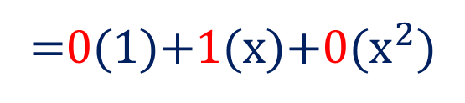


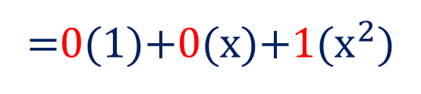









Method:2 $⇝$ Example:2
Example
Let $T∶ℙ_{1}→ℙ_{2}$ be the linear transformation defined by
$T\left(p\left(x\right)\right)=x\left(p\left(x\right)\right).$ Find the matrix $\left[T\right]$.
Solution
Standard basis of $ℙ_{1}$ is
$\left\{1,x\right\}$
and Standard basis of $ℙ_{2}$ is
$\left\{1,x,x^{2}\right\}$
$$T\left(1\right)=$$
$$x∙(1)$$
The standard matrix is
$$=x$$
$$0$$
$$1$$
$$0$$
$$0$$
$$0$$
$$1$$
=0(1)+1(x)+0($x^{2})$
$$T\left(x\right)=$$
$$x∙(x)$$
$$[T]=$$
$$=x^{2}$$
$$3×2$$
=0(1)+0(x)+1($x^{2})$

Slide 38
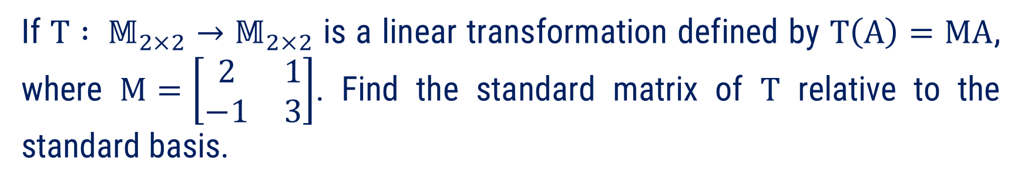

Method:2 $⇝$ Example:3
If $T : 𝕄_{2×2}→𝕄_{2×2}$ is a linear transformation defined by $T\left(A\right)=MA$, where $M=\left[\begin{matrix}2 & 1 \\ −1 & 3\end{matrix}\right]$. Find the standard matrix of $T$ relative to the standard basis.
Example
Solution
Standard basis of $𝕄_{2×2}$are
$$E_{1}=\left[ \begin{matrix}1 & 0 \\ 0 & 0\end{matrix} \right], E_{2}=\left[ \begin{matrix}0 & 1 \\ 0 & 0\end{matrix} \right],E_{3}=\left[ \begin{matrix}0 & 0 \\ 1 & 0\end{matrix} \right],E_{4}=\left[ \begin{matrix}0 & 0 \\ 0 & 1\end{matrix} \right]$$

Slide 39


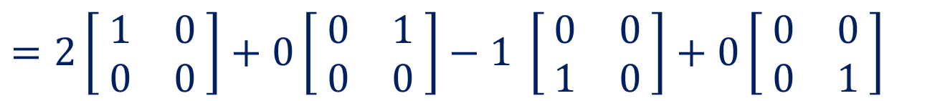
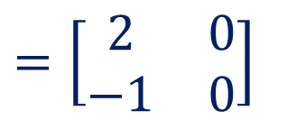
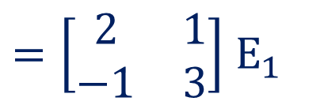
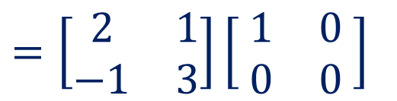
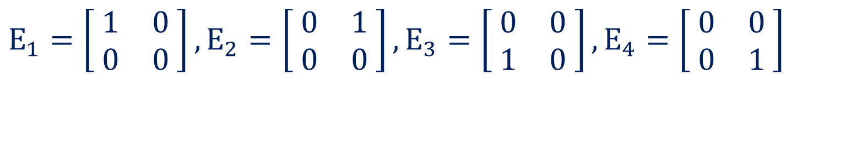
Method:2 $⇝$ Example:3(Continue)
Now, $T\left(E_{1}\right)$
$=\left[\begin{matrix}2 & 1 \\ −1 & 3\end{matrix}\right]$ $E_{1}$
$T\left(A\right)=MA$, where $M=\left[\begin{matrix}2 & 1 \\ −1 & 3\end{matrix}\right]$
$$=\left[\begin{matrix}2 & 1 \\ −1 & 3\end{matrix}\right]\left[ \begin{matrix}1 & 0 \\ 0 & 0\end{matrix} \right]$$
$$=\left[\begin{matrix}2 & 0 \\ −1 & 0\end{matrix}\right]$$
$$=2\left[ \begin{matrix}1 & 0 \\ 0 & 0\end{matrix} \right]+0\left[ \begin{matrix}0 & 1 \\ 0 & 0\end{matrix} \right]−1 \left[ \begin{matrix}0 & 0 \\ 1 & 0\end{matrix} \right]+0\left[ \begin{matrix}0 & 0 \\ 0 & 1\end{matrix} \right]$$
$$∴T\left(E_{1}\right)=2E_{1}+0E_{2}−1E_{3}+0E_{4}$$
$$E_{1}=\left[ \begin{matrix}1 & 0 \\ 0 & 0\end{matrix} \right], E_{2}=\left[ \begin{matrix}0 & 1 \\ 0 & 0\end{matrix} \right],E_{3}=\left[ \begin{matrix}0 & 0 \\ 1 & 0\end{matrix} \right],E_{4}=\left[ \begin{matrix}0 & 0 \\ 0 & 1\end{matrix} \right]$$

Slide 40





Method:2 $⇝$ Example:3(Continue)
Now, $T\left(E_{2}\right)$
$=\left[\begin{matrix}2 & 1 \\ −1 & 3\end{matrix}\right]$ $E_{2}$
$T\left(A\right)=MA$, where $M=\left[\begin{matrix}2 & 1 \\ −1 & 3\end{matrix}\right]$
$$=\left[\begin{matrix}2 & 1 \\ −1 & 3\end{matrix}\right]\left[ \begin{matrix}0 & 1 \\ 0 & 0\end{matrix} \right]$$
$$=\left[\begin{matrix}0 & 2 \\ 0 & −1\end{matrix}\right]$$
$$=0\left[ \begin{matrix}1 & 0 \\ 0 & 0\end{matrix} \right]+2\left[ \begin{matrix}0 & 1 \\ 0 & 0\end{matrix} \right]+0\left[ \begin{matrix}0 & 0 \\ 1 & 0\end{matrix} \right]−1\left[ \begin{matrix}0 & 0 \\ 0 & 1\end{matrix} \right]$$
$$∴T\left(E_{2}\right)=0E_{1}+2E_{2}+0E_{3}−1E_{4}$$
$$E_{1}=\left[ \begin{matrix}1 & 0 \\ 0 & 0\end{matrix} \right], E_{2}=\left[ \begin{matrix}0 & 1 \\ 0 & 0\end{matrix} \right],E_{3}=\left[ \begin{matrix}0 & 0 \\ 1 & 0\end{matrix} \right],E_{4}=\left[ \begin{matrix}0 & 0 \\ 0 & 1\end{matrix} \right]$$

Slide 41





Method:2 $⇝$ Example:3(Continue)
Now, $T\left(E_{3}\right)$
$=\left[\begin{matrix}2 & 1 \\ −1 & 3\end{matrix}\right]$ $E_{3}$
$T\left(A\right)=MA$, where $M=\left[\begin{matrix}2 & 1 \\ −1 & 3\end{matrix}\right]$
$$=\left[\begin{matrix}2 & 1 \\ −1 & 3\end{matrix}\right]\left[ \begin{matrix}0 & 0 \\ 1 & 0\end{matrix} \right]$$
$$=\left[\begin{matrix}1 & 0 \\ 3 & 0\end{matrix}\right]$$
$$=1\left[ \begin{matrix}1 & 0 \\ 0 & 0\end{matrix} \right]+0\left[ \begin{matrix}0 & 1 \\ 0 & 0\end{matrix} \right]+3\left[ \begin{matrix}0 & 0 \\ 1 & 0\end{matrix} \right]+0\left[ \begin{matrix}0 & 0 \\ 0 & 1\end{matrix} \right]$$
$$∴T\left(E_{3}\right)=1E_{1}+0E_{2}+3E_{3}+0E_{4}$$
$$E_{1}=\left[ \begin{matrix}1 & 0 \\ 0 & 0\end{matrix} \right], E_{2}=\left[ \begin{matrix}0 & 1 \\ 0 & 0\end{matrix} \right],E_{3}=\left[ \begin{matrix}0 & 0 \\ 1 & 0\end{matrix} \right],E_{4}=\left[ \begin{matrix}0 & 0 \\ 0 & 1\end{matrix} \right]$$

Slide 42





Method:2 $⇝$ Example:3(Continue)
Now, $T\left(E_{4}\right)$
$=\left[\begin{matrix}2 & 1 \\ −1 & 3\end{matrix}\right]$ $E_{4}$
$T\left(A\right)=MA$, where $M=\left[\begin{matrix}2 & 1 \\ −1 & 3\end{matrix}\right]$
$$=\left[\begin{matrix}2 & 1 \\ −1 & 3\end{matrix}\right]\left[ \begin{matrix}0 & 0 \\ 0 & 1\end{matrix} \right]$$
$$=\left[\begin{matrix}0 & 1 \\ 0 & 3\end{matrix}\right]$$
$$=0\left[ \begin{matrix}1 & 0 \\ 0 & 0\end{matrix} \right]+1\left[ \begin{matrix}0 & 1 \\ 0 & 0\end{matrix} \right]+0\left[ \begin{matrix}0 & 0 \\ 1 & 0\end{matrix} \right]+3\left[ \begin{matrix}0 & 0 \\ 0 & 1\end{matrix} \right]$$
$$∴T\left(E_{4}\right)=0E_{1}+1E_{2}+0E_{3}+3E_{4}$$
$$E_{1}=\left[ \begin{matrix}1 & 0 \\ 0 & 0\end{matrix} \right], E_{2}=\left[ \begin{matrix}0 & 1 \\ 0 & 0\end{matrix} \right],E_{3}=\left[ \begin{matrix}0 & 0 \\ 1 & 0\end{matrix} \right],E_{4}=\left[ \begin{matrix}0 & 0 \\ 0 & 1\end{matrix} \right]$$

Slide 43






Method:2 $⇝$ Example:3(Continue)
The standard matrix is
$$2$$
$$0$$
$$−1$$
$$0$$
$$0$$
$$2$$
$$0$$
$$−1$$
$$1$$
$$0$$
$$3$$
$$0$$
$$0$$
$$1$$
$$0$$
$$3$$
$$[T]=$$
$$4×4$$
$$T\left(E_{2}\right)=0E_{1}+2E_{2}+0E_{3}−1E_{4}$$
$$T\left(E_{3}\right)=1E_{1}+0E_{2}+3E_{3}+0E_{4}$$
$$T\left(E_{4}\right)=0E_{1}+1E_{2}+0E_{3}+3E_{4}$$
$$T\left(E_{1}\right)=2E_{1}+0E_{2}−1E_{3}+0E_{4}$$

Slide 44













Method:2 $⇝$ Example:4
$$ker\left(T\right)=\left\{v∈V :T\left(v\right)=0\right\}$$
Example
Let $T : ℝ^{2}→ℝ^{2}$ be the linear operator defined by
$T\left(x,y\right)=(2x−y, −8x+4y)$, then find the bases of $ker\left(T\right)$ and $R(T)$.
Solution
Let $v=\left(x,y\right)∈ℝ^{2} :$
$$T\left(v\right)=T\left(x,y\right)=\left(2x−y, −8x+4y\right)=(0,0)$$
$$⇒2x−y =0$$
Consider the Augmented Matrix
$$−8x+4y=0$$
Let’s write above system in $AX=B$form.
$$\left[A \right| B]=\left[ \begin{matrix}2 & −1 & 0 \\ −8 & 4 & 0\end{matrix} \right]$$
Where
$$A=\left[ \begin{matrix}2 & −1 \\ −8 & 4\end{matrix} \right],$$
$$X=\left[ \begin{matrix}x \\ y\end{matrix} \right]$$
$$\sim$$
$$\left[ \begin{matrix}2 & −1 & 0 \\ 0 & 0 & 0\end{matrix} \right]$$
$$R_{12}\left(4\right)$$
and $B=\left[ \begin{matrix}0 \\ 0\end{matrix} \right]$

Slide 45










Method:2 $⇝$ Example:4(Continue)
$$\sim$$
$$\left[ \begin{matrix}2 & −1 & 0 \\ 0 & 0 & 0\end{matrix} \right]$$
$$R_{12}\left(4\right)$$
$$∴\ker\left(T\right)=\text{span}\left\{\left(\frac{ 1 }{ 2 },1\right)\right\}$$
$$⇒2x−y=0$$
$$⇒2x=y$$
$$\text{Hence}\text{, }\text{Basis} \text{of}\ker\left(T\right)=\left\{\left(\frac{ 1 }{ 2 }, 1\right)\right\}$$
Let$y=t; t∈ℝ$
$$⇒x=\frac{ t }{ 2 }$$
$$\left\{ t\left(\frac{ 1 }{ 2 }, 1 \right) | t∈ ℝ \right\}$$
Solution Set:

Slide 46













Method:2 $⇝$ Example:4(Continue)
Standard basis of $ℝ^{2} :$
$e_{1}=\left(1, 0\right),$ $e_{2}=\left(0, 1\right)$
$$T\left(e_{1}\right)=T\left(1,0\right)$$
The standard matrix is
$$=(2−0, −8+0)$$
$$2$$
$$−8$$
$$−1$$
$$4$$
$$=(2,−8)$$
$$[T]=$$
$$T\left(e_{2}\right)=T\left(0,1\right)$$
$$2×2$$
$$=(0−1, −0+4)$$
$$=(−1, 4)$$
$$T\left(x,y\right)=(2x−y, −8x+4y)$$

Slide 47





Method:2 $⇝$ Example:4(Continue)
Now$, [T]=\left[ \begin{matrix}2 & −1 \\ −8 & 4\end{matrix} \right]$
$\left[ \begin{matrix}1 & −\frac{ 1 }{ 2 } \\ 0 & 0\end{matrix} \right]$.
Row echelon form of $[T]$ with leading element ‘1’ is
The leading 1’s appear in column 1 only.
$=\left\{\left[\begin{aligned}2 \\ −8\end{aligned}\right]\right\}$.
Hence, basis of $R\left(T\right)=$basis of Col($\left[T\right]$)
$$\text{Hence}\text{, }\text{Basis} \text{of}R\left(T\right)=\left\{\left(2,−8\right)\right\}.$$

Slide 48











Method:2 $⇝$ Example:5
$$ker\left(T\right)=\left\{v∈V :T\left(v\right)=0\right\}$$
Example
If $T : ℙ_{2}→ℙ_{3}$ be the linear transformation defined by
$T\left(p\left(x\right)\right)=x∙p\left(x\right)$, then find the bases of $ker\left(T\right)$ and $R(T)$.
Solution
Let $p\left(x\right)=a+bx+{cx}^{2}∈ℙ_{2}$
$$⇒ ax+{bx}^{2}+{cx}^{3}=0x+{0x}^{2}+{0x}^{3}$$
$$⇒T\left(p\left(x\right)\right)=x∙p\left(x\right)$$
$$⇒ a=0, b=0, c=0$$
$$=x(a+bx+{cx}^{2})$$
$$⇒p\left(x\right)=0x+{0x}^{2}+{0x}^{3}=0$$
$$=ax+{bx}^{2}+{cx}^{3}$$
$$∴\ker\left(T\right)=\left\{0\right\}$$
For kernel$,T\left(p\left(x\right)\right)=0$
$$\text{Hence}\text{, }\text{Basis} \text{of}\ker\left(T\right)=φ$$
$$⇒ ax+{bx}^{2}+{cx}^{3}=0$$

Slide 49






















Method:2 $⇝$ Example:5(Continue)
$$T\left(p\left(x\right)\right)=x∙p\left(x\right)$$
Standard basis of $ℙ_{2}$ is
$\left\{1,x,x^{2}\right\}$
and standard basis of $ℙ_{3}$ is
$\left\{1,x,x^{2},x^{3}\right\}$
$$T\left(1\right) =$$
$$x∙(1)$$
$$=x$$
The standard matrix is
$$= 0(1)+1(x)+0(x^{2})+0(x^{3})$$
$$0$$
$$1$$
$$0$$
$$0$$
$$0$$
$$0$$
$$1$$
$$0$$
$$0$$
$$0$$
$$0$$
$$1$$
$$T\left(x\right) =$$
$$x∙(x)$$
$$=x^{2}$$
$$[T]=$$
$$= 0(1)+0(x)+1(x^{2})+0(x^{3})$$
$$T\left(x^{2}\right)=$$
$$x∙(x^{2})$$
$$4×3$$
$$=x^{3}$$
$= 0(1)+0(x)+$0($x^{2})+1(x^{3})$

Slide 50










Method:2 $⇝$ Example:5(Continue)
$$1$$
$$0$$
$$0$$
$$0$$
$$0$$
$$1$$
$$0$$
$$0$$
$$0$$
$$0$$
$$1$$
$$0$$
Row echelon form of $[T]$ is
The leading $1$’s appear in columns $1, 2$ and $3$.
$$0$$
$$1$$
$$0$$
$$0$$
$$0$$
$$0$$
$$1$$
$$0$$
$$0$$
$$0$$
$$0$$
$$1$$
Basis of Col$\left(\left[T\right]\right)=$
,
,

Slide 51





Method:2 $⇝$ Example:5(Continue)
$$0$$
$$1$$
$$0$$
$$0$$
$$0$$
$$0$$
$$1$$
$$0$$
$$0$$
$$0$$
$$0$$
$$1$$
Basis of Col$\left(\left[T\right]\right)=$
,
,
The above column vectors correspond to the polynomials $x, x^{2}, x^{3}$.
Basis of $R\left(T\right)=\{x, x^{2}, x^{3}\}$.

Slide 52





Method:2 $⇝$ Example:6
$$ker\left(T\right)=\left\{v∈V :T\left(v\right)=0\right\}$$
Let $T : 𝕄_{2×2}→𝕄_{2×2}$ be the linear transformation defined by
$T\left[ \begin{matrix}a & b \\ c & d\end{matrix} \right]=\left[ \begin{matrix}a+b & b+c \\ a+d & b+d\end{matrix} \right]$, then find the bases of $ker\left(T\right)$ and $R\left(T\right).$ Also find $rank\left(T\right)$ and $nullity(T)$.
Example
Let $v=\left[ \begin{matrix}a & b \\ c & d\end{matrix} \right]∈𝕄_{2×2} :T\left(v\right)=0$
Solution
$$T\left[ \begin{matrix}a & b \\ c & d\end{matrix} \right]=\left[ \begin{matrix}a+b & b+c \\ a+d & b+d\end{matrix} \right]=\left[ \begin{matrix}0 & 0 \\ 0 & 0\end{matrix} \right]$$
$⇒a+b=0$, $b+c=0$
$a+d=0$, $b+d=0$

Slide 53















Method:2 $⇝$ Example:6(Continue)
Let’s write above system in $AX=B$form.
$A=\left[ \begin{matrix}1 & 1 & 0 & 0 \\ 0 & 1 & 1 & 0 \\ 1 & 0 & 0 & 1 \\ 0 & 1 & 0 & 1\end{matrix} \right]$
$X=\left[ \begin{matrix}a \\ b \\ c \\ d\end{matrix} \right]$
$B=\left[ \begin{matrix}0 \\ 0 \\ 0 \\ 0\end{matrix} \right]$
Where
Consider the Augmented Matrix
$$1 1 0 0$$
$$0$$
$$0 1 1 0$$
$$0$$
$$\left[ \left.A \right| B \right]$$
$$=$$
$$1 0 0 1$$
$$0$$
$$0 1 0 1$$
$$0$$

Slide 54

























Method:2 $⇝$ Example:6(Continue)
$$1 1 0 0$$
$$0$$
Apply the Back Substitution,
$$0 1 1 0$$
$$0$$
$$d =0$$
$$\left[ \left.A \right| B \right]$$
$$=$$
$$1 0 0 1$$
$$0$$
$$c+d =0$$
$$⇒c=0$$
$$0 1 0 1$$
$$0$$
$$b+c =0$$
$$⇒b=0$$
Row - echelon form of $\left[ \left.A \right| B \right]$ is
$$a+b =0$$
$$⇒a=0$$
$$a$$
$$b$$
$$c$$
$$d$$
$$1 1 0 0$$
$$0$$
$$⇒Ker\left(T\right)=\left\{\left[ \begin{matrix}a & b \\ c & d\end{matrix} \right]\right\}=$$
$$\left\{\left[ \begin{matrix}0 & 0 \\ 0 & 0\end{matrix} \right]\right\}$$
$$0 1 1 0$$
$$0$$
$$\sim$$
$$0 0 1 1$$
$$0$$
$$\text{Hence}\text{, }\text{Basis} \text{of}\ker\left(T\right)=φ$$
$$0 0 0 1$$
$$0$$
$$⇒nullity\left(T\right)=\dim\left(ker\left(T\right)\right)=0$$

Slide 55



Method:2 $⇝$ Example:6(Continue)
Now,$T\left(\left[ \begin{matrix}a & b \\ c & d\end{matrix} \right]\right)=\left[ \begin{matrix}a+b & b+c \\ a+d & b+d\end{matrix} \right]$
$$=a\left[ \begin{matrix}1 & 0 \\ 1 & 0\end{matrix} \right]+b\left[ \begin{matrix}1 & 1 \\ 0 & 1\end{matrix} \right]+c\left[ \begin{matrix}0 & 1 \\ 0 & 0\end{matrix} \right]+d\left[ \begin{matrix}0 & 0 \\ 1 & 1\end{matrix} \right]$$
This four vectors ($A_{1},A_{2},A_{3}$ and $A_{4}$) are linearly independent as
Now, $c_{1}A_{1}+c_{2}A_{2}+c_{3}A_{3}+c_{4}A_{4}=0$
$$⇒c_{1}\left[ \begin{matrix}1 & 0 \\ 1 & 0\end{matrix} \right]+c_{2}\left[ \begin{matrix}1 & 1 \\ 0 & 1\end{matrix} \right]+c_{3}\left[ \begin{matrix}0 & 1 \\ 0 & 0\end{matrix} \right]+c_{4}\left[ \begin{matrix}0 & 0 \\ 1 & 1\end{matrix} \right]=\left[ \begin{matrix}0 & 0 \\ 0 & 0\end{matrix} \right]$$
$$⇒\left[ \begin{matrix}c_{1}+c_{2} & c_{2}+c_{3} \\ c_{1}+c_{4} & c_{2}+c_{4}\end{matrix} \right]=\left[ \begin{matrix}0 & 0 \\ 0 & 0\end{matrix} \right]$$

Slide 56







Method:2 $⇝$ Example:6(Continue)
$$R\left(T\right)=\{T\left(v\right)∈W :v∈V\}$$
$$⇒\left[ \begin{matrix}c_{1}+c_{2} & c_{2}+c_{3} \\ c_{1}+c_{4} & c_{2}+c_{4}\end{matrix} \right]=\left[ \begin{matrix}0 & 0 \\ 0 & 0\end{matrix} \right]$$
$\text{Hence}\text{, }\text{Basis} \text{of}$ $R(T)=\left\{\left[ \begin{matrix}1 & 0 \\ 1 & 0\end{matrix} \right],\left[ \begin{matrix}1 & 1 \\ 0 & 1\end{matrix} \right],\left[ \begin{matrix}0 & 1 \\ 0 & 0\end{matrix} \right],\left[ \begin{matrix}0 & 0 \\ 1 & 1\end{matrix} \right]\right\}$
Comparing both the sides, we have
$c_{1}+c_{2}=0$ , $c_{2}+c_{3}=0$
$$c_{1}+c_{4}=0, c_{2}+c_{4}=0$$
$$⇒rank\left(T\right)=\dim\left(R\left(T\right)\right)=4$$
Solving these equations,
We get $c_{1}=c_{2}=c_{3}=c_{3}=0$
Hence, $A_{1},A_{2},A_{3}$ and $A_{4}$ are L.I.

Slide 57












Method:2 $⇝$ Example:7
$$ker\left(T\right)=\left\{v∈V :T\left(v\right)=0\right\}$$
Example
Verify rank-nullity theorem for the linear transformation
$T∶ℝ^{3}→ℝ^{2}$ defined by $T\left(x,y,z\right)=\left(x+y+z, x+y\right).$
Solution
Let $v=\left(x,y,z\right)∈ℝ^{3} :$
$$T\left(v\right)=T\left(x,y,z\right)=\left(x+y+z, x+y\right)=(0, 0)$$
$$⇒x+y+z=0$$
Consider the Augmented Matrix
$$x+y=0$$
Let’s write above system in $AX=B$form.
$$\left[A \right| B]=\left[ \begin{matrix}1 & 1 & 1 0 \\ 1 & 1 & 0 0\end{matrix} \right]$$
$$X=\left[ \begin{matrix}x \\ y \\ z\end{matrix} \right]$$
$$A=\left[ \begin{matrix}1 & 1 & 1 \\ 1 & 1 & 0\end{matrix} \right]\text{,}$$
$$\sim$$
$$\left[ \begin{matrix}1 & 1 & 1 0 \\ 0 & 0 & −1 0\end{matrix} \right]$$
and $B=\left[ \begin{matrix}0 \\ 0\end{matrix} \right]$
$$R_{12}\left(−1\right)$$

Slide 58














Method:2 $⇝$ Example:7(Continue)
$$x$$
$$y$$
$$z$$
Solution Set:
$$\left\{ t\left(−1, 1, 0\right) | t∈ ℝ\right\}$$
$$\sim$$
$$\left[ \begin{matrix}1 & 1 & 1 0 \\ 0 & 0 & −1 0\end{matrix} \right]$$
$$∴\ker\left(T\right)=\text{span}\left\{\left(−1, 1, 0\right)\right\}$$
$$⇒−z=0$$
$$\text{Hence}\text{, }\text{Basis} \text{of}\ker\left(T\right)=\left\{\left(−1, 1,0\right)\right\}$$
$$⇒z=0$$
$$⇒nullity\left(T\right)=\dim\left(ker\left(T\right)\right)=1$$
Let$y=t; t∈ℝ$
$$x+y+z=0$$
$$⇒x+t+0=0$$
$$⇒x=−t$$

Slide 59






Method:2 $⇝$ Example:7(Continue)
$$R\left(T\right)=\{T\left(v\right)∈W :v∈V\}$$
For any$\left(x,y,z\right)∈ℝ^{3} ,$
$$T\left(x,y,z\right)=\left(x+y+z, x+y\right)$$
$$=x(1, 1)+y(1, 1)+z(1, 0)$$
$$⇒R(T)=span\left\{\left(1, 1\right),(1, 0)\right\}$$
since $\left(1, 1\right),\left(1, 0\right)$ are linearly independent.
$\text{Hence}\text{, }\text{Basis} \text{of}$ $R(T)=\left\{\left(1, 1\right),(1, 0)\right\}$
$$⇒rank\left(T\right)=\dim\left(R\left(T\right)\right)=2$$

Slide 60





Method:2 $⇝$ Example:7(Continue)
For verification of Rank-Nullity Theorem,
We have, $nullity\left(T\right)=\dim\left(ker\left(T\right)\right)=1$
$$rank\left(T\right)=\dim\left(R\left(T\right)\right)=2$$
Now$, rank\left(T\right)+nullity\left(T\right)=2+1$
$$=3$$
$$=\dim\left(ℝ^{3}\right)$$
Hence, Rank-Nullity Theorem is verified.

Slide 61
Method-3
Matrix Representation of Linear Transformation

Slide 62

Associated Matrix of Linear Transformation with Respect to Basis
Let $T∶V→W$ be a linear transformation.
If $S_{1}$ is a basis of vector space $V$ and $S_{2}$ is a basis of vector space $W$, then the matrix associated to $T$ with respect to $S_{1} \& S_{2}$ is denoted by
$${[T]}_{S_{2}, S_{1}}={\left[T\right]}_{codomain basis, domain basis}$$

Slide 63


Procedure to Find the Matrix Associated to Linear Transformation T
Let $S_{1}=\left\{v_{1}, v_{2},…, v_{n}\right\}$ is basis of V and $S_{2}=\left\{w_{1}, w_{2},…, w_{m}\right\}$ is basis of W.
1) Find $T\left(v_{1}\right), T\left(v_{2}\right), …, T(v_{n})$.
2) Each element of $W$ can be written in the linear combination of the elements of set $S_{2}$. So, write obtained elements as follows.
$$T\left(v_{1}\right)=k_{1}^{1}w_{1}+k_{2}^{1}w_{2}+…+k_{m}^{1}w_{m}$$
$T\left(v_{2}\right)=k_{1}^{2}w_{1}+k_{2}^{2}w_{2}+…+k_{m}^{2}w_{m}$
$$T\left(v_{n}\right)=k_{1}^{n}w_{1}+k_{2}^{n}w_{2}+…+k_{m}^{n}w_{m}$$
…

Slide 64


Procedure to Find the Matrix Associated to Linear Transformation T
3) Write $k_{1}^{i}, k_{2}^{i}, …, k_{m}^{i}$ into the $i^{th}$ column of the matrix for each $i∈\left\{1, 2, …, n\right\}$.
4) The resulting matrix ${\left[T\right]}_{S_{2}, S_{1}}=\left[\begin{matrix}k_{1}^{1} & ⋯ & k_{1}^{n} \\ ⋮ & ⋱ & ⋮ \\ k_{m}^{1} & ⋯ & k_{m}^{n}\end{matrix}\right]$ is the matrix associated to $T$ with respect to $S_{1} and S_{2}$.
Remarks:
If $T :V→W$ is a linear transformation with $dim\left(V\right)=n$ and $dim\left(W\right)=m,$ then the matrix associated to $T$ is of order $m×n$.
If $S_{1}$ and $S_{2}$ are the standard bases of $V$ and $W$ respectively, then ${\left[T\right]}_{S_{2},S_{1}}=[T]$.

Slide 65





Method:3 $⇝$ Example:1
Example
Let $T : ℝ^{2}→ℝ^{3}$ be the linear transformation defined by
$T\left(x, y\right)=\left(y, −5x+13y, −7x+16y\right).$ Find the matrix of the transformation $T$ with respect to the bases $S_{1}=\{v_{1}, v_{2}\}$ for $ℝ^{2}$ and $S_{2}=\{w_{1}, w_{2}, w_{3}\}$ for $ℝ^{3}$, where $v_{1}=\left(3, 1\right), v_{2}=\left(5, 2\right),$
$w_{1}=\left(1, 0, −1\right), w_{2}=\left(−1, 2, 2\right)$ and $w_{3}=\left(0, 1, 2\right)$.
Solution
For $v_{1}=(3, 1)$
$$T(v_{1})=T(3, 1)=(1,−5\left(3\right)+13\left(1\right),−7\left(3\right)+16\left(1\right))$$
$$=(1,−2,−5)$$
$$v_{2}=(5, 2)$$
$$T(v_{2})=T(5, 2)=(2,−5\left(5\right)+13\left(2\right),−7\left(5\right)+16\left(2\right))$$
$$=(2, 1, −3)$$

Slide 66





Method:3 $⇝$ Example:1(Continue)
Express the vector $T\left(v_{1}\right)$as linear combination of $w_{1},w_{2} and w_{3}.$
$$T\left(v_{1}\right)={k_{1}w}_{1}+k_{2}w_{2}+k_{3}w_{3}$$
$$⇒(1,−2,−5)=k_{1}w_{1}+k_{2}w_{2}+k_{3}w_{3}$$
$$⇒(1,−2,−5)=k_{1}\left(1, 0, −1\right)+k_{2}\left(−1, 2, 2\right)+k_{3}\left(0, 1, 2\right)$$
Equating corresponding components,
$$k_{1}−k_{2}=1,$$
$$2k_{2}+k_{3}=−2,$$
$$−k_{1}+2k_{2}+2k_{3}=−5$$
Solving these equations,
We get $k_{1}=1, k_{2}=0, k_{3}=−2$
$$⇒T\left(v_{1}\right)=1∙w_{1}+0∙w_{2}−2⋅w_{3}$$
$w_{1}=\left(1, 0, −1\right), w_{2}=\left(−1, 2, 2\right)$ and $w_{3}=\left(0, 1, 2\right)$
$$T\left(v_{1}\right)=(1,−2,−5)$$

Slide 67





Method:3 $⇝$ Example:1(Continue)
Express the vector $T\left(v_{2}\right)$as linear combination of $w_{1},w_{2} and w_{3}.$
$$T\left(v_{2}\right)={k_{1}w}_{1}+k_{2}w_{2}+k_{3}w_{3}$$
$$⇒(2, 1,−3)=k_{1}w_{1}+k_{2}w_{2}+k_{3}w_{3}$$
$$⇒(2, 1,−3)=k_{1}\left(1, 0, −1\right)+k_{2}\left(−1, 2, 2\right)+k_{3}\left(0, 1, 2\right)$$
Equating corresponding components,
$$k_{1}−k_{2}=2,$$
$$2k_{2}+k_{3}=1,$$
$$−k_{1}+2k_{2}+2k_{3}=−3$$
Solving these equations,
We get $k_{1}=3, k_{2}=1, k_{3}=−1$
$$⇒T\left(v_{2}\right)=3∙w_{1}+1⋅w_{2}−1∙w_{3}$$
$w_{1}=\left(1, 0, −1\right), w_{2}=\left(−1, 2, 2\right)$ and $w_{3}=\left(0, 1, 2\right)$
$$T\left(v_{2}\right)=(2,1,−3)$$

Slide 68





Method:3 $⇝$ Example:1(Continue)
The matrix of the transformation with respect to the bases $S_{1}$ and $S_{2}$ is
$$1$$
$$0$$
$$−2$$
$$3$$
$$1$$
$$−1$$
$${\left[T\right]}_{S_{2}, S_{1}}=$$
$$3×2$$
$$T\left(v_{1}\right)=1∙w_{1}+0∙w_{2}−2⋅w_{3}$$
$$T\left(v_{2}\right)=3∙w_{1}+1⋅w_{2}−1∙w_{3}$$

Slide 69







Method:3 $⇝$ Example:2
Example
Let $T : ℙ^{1}→ℙ^{2}$ be the defined by $T\left(p\left(x\right)\right)=x∙\left(p\left(x\right)\right).$
Find the matrix of the transformation $T$ with respect to the bases
$S_{1}=\{v_{1}, v_{2}\}$and$S_{2}=\left\{w_{1}, w_{2}, w_{3}\right\},$where $v_{1}=1, v_{2}=x,$
$w_{1}=x+1, w_{2}=x−1$ and $w_{3}=x^{2}$.
Solution
For $v_{1}=1$
$$T\left(v_{1}\right)=T\left(1\right)=x∙1$$
$$=x$$
$$v_{2}=x$$
$$T\left(v_{2}\right)=T\left(x\right)=x∙x$$
$$=x^{2}$$

Slide 70







Method:3 $⇝$ Example:2(Continue)
Express the vector $T\left(v_{1}\right)$as linear combination of $w_{1},w_{2} and w_{3}.$
$$T\left(v_{1}\right)={k_{1}w}_{1}+k_{2}w_{2}+k_{3}w_{3}$$
$$⇒x=k_{1}\left(x+1\right)+k_{2}\left(x−1\right)+k_{3}\left(x^{2}\right)$$
$$⇒x=\left(k_{1}−k_{2}\right)+\left(k_{1}+k_{2}\right)x+k_{3}x^{2}$$
Equating corresponding components,
$$k_{1}−k_{2}=0,$$
$$k_{1}+k_{2}=1,$$
$$k_{3}=0$$
Solving these equations,
$$\text{We} \text{get} k_{1}=\frac{ 1 }{ 2 }, k_{2}=\frac{ 1 }{ 2 }, k_{3}=0$$
$$T\left(v_{1}\right)=x$$
$$⇒T\left(v_{1}\right)=\frac{ 1 }{ 2 }∙w_{1}+\frac{ 1 }{ 2 }∙w_{2}+0⋅w_{3}$$
$w_{1}=\left(x+1\right), w_{2}=\left(x−1\right)$ and $w_{3}=x^{2}$

Slide 71




Method:3 $⇝$ Example:2(Continue)
Express the vector $T\left(v_{2}\right)$as linear combination of $w_{1},w_{2} and w_{3}.$
$$T\left(v_{2}\right)={k_{1}w}_{1}+k_{2}w_{2}+k_{3}w_{3}$$
$$⇒x^{2}=k_{1}\left(x+1\right)+k_{2}\left(x−1\right)+k_{3}\left(x^{2}\right)$$
$$⇒x^{2}=\left(k_{1}−k_{2}\right)+\left(k_{1}+k_{2}\right)x+k_{3}x^{2}$$
Equating corresponding components,
$$k_{1}−k_{2}=0,$$
$$k_{1}+k_{2}=0,$$
$$k_{3}=1$$
Solving these equations,
$$\text{We} \text{get} k_{1}=0, k_{2}=0, k_{3}=1$$
$$T\left(v_{2}\right)=x^{2}$$
$$⇒T\left(v_{2}\right)={0∙w}_{1}+0∙w_{2}+1∙w_{3}$$
$w_{1}=\left(x+1\right), w_{2}=\left(x−1\right)$ and $w_{3}=x^{2}$

Slide 72










Method:3 $⇝$ Example:2(Continue)
The matrix of the transformation $T$ with respect to the bases $S_{1}$ and $S_{2}$ is
$$\frac{ 1 }{ 2 }$$
$$0$$
$${\left[T\right]}_{S_{2}, S_{1}}=$$
$$\frac{ 1 }{ 2 }$$
$$0$$
$$0$$
$$1$$
$$3×2$$
$$T\left(v_{1}\right)=\frac{ 1 }{ 2 }∙w_{1}+\frac{ 1 }{ 2 }∙w_{2}+0⋅w_{3}$$
$$T\left(v_{2}\right)=0∙w_{1}+0∙w_{2}+1⋅w_{3}$$

Slide 73

Matrices of Identity Operators
Let $T : V→V$ be a linear operator. If $S_{1}=\{v_{1},v_{2},…,v_{n}\}$ and
$S_{2}=\{w_{1},w_{2},…,w_{n}\}$ are two different non-standard bases of $V$, then
  ${\left[T\right]}_{S_{1}}$ denotes the matrix of $T$ when the domain and codomain use the same basis $S_{1}$​.
  ${\left[T\right]}_{S_{2}}$ denotes the matrix of $T$ when the domain and codomain use the same basis $S_{2}$​.
  ${\left[T\right]}_{S_{2}, S_{1}}$ denotes the matrix of $T$ with respect to basis $S_{1}$ of the domain and basis $S_{2}$​ of the codomain.
  ${\left[T\right]}_{S_{1}, S_{2}}$ denotes the matrix of $T$ with respect to basis $S_{2}$ of the domain and basis $S_{1}$​ of the codomain.

Slide 74








Method:3 $⇝$ Example:3
Example
Let $T∶ℝ^{3}→ℝ^{3}$be the linear operator defined by
$T\left(x,y, z\right)=\left(x+2y+z, 2x−y, 2y+z\right).$Find the matrix of transformation$T$w.r.t$\left(i\right) S_{1}, \left(ii\right) S_{1} \& S_{2}, \left(iii\right) S_{2} \& S_{1}, \left(iv\right) S_{2}$
where, $S_{1}=\left\{\left(1, 0, 0\right), \left(0, 1, 0\right), (0, 0, 1)\right\}$ and
$S_{2}=\left\{\left(1, 0, 1\right), \left(0, 1, 1\right), (0, 0, 1)\right\}$.
Solution
(i) Consider $S_{1}$ is the standard basis of domain and codomain both,
the matrix of $T$ w.r.t $S_{1}$ is the standard matrix of $T$.
$$1 2 1$$
Directly, ${\left[T\right]}_{S_{1}}=[T]=$
($∵S_{1}$is the standard basis)
$$2 −1 0$$
$$0 2 1$$

Slide 75







Method:3 $⇝$ Example:3(Continue)
$$S_{1}=\left\{\left(1, 0, 0\right), \left(0, 1, 0\right), (0, 0, 1)\right\}$$
(ii) Consider $S_{1}$ is the basis of domain and $S_{2}$ is the basis of codomain, the matrix
of $T$ w.r.t $S_{1}\& S_{2}$ is the matrix of $T$.
For $v_{1}=(1, 0, 0)$
$$T\left(v_{1}\right)=T(1, 0, 0)=(1+2\left(0\right)+0, 2−0, 2\left(0\right)+0)$$
$$=(1, 2, 0)$$
For $v_{2}=(0, 1, 0)$
$$T\left(v_{2}\right)=T(0, 1, 0)=(0+2\left(1\right)+0, 2(0)−1, 2\left(0\right)+0)$$
$$=(2,−1, 2)$$
For $v_{3}=(0, 0, 1)$
$$T\left(v_{3}\right)=T(0, 0, 1)=(0+2\left(0\right)+1, 2(0)−0, 2\left(0\right)+1)$$
$$=(1, 0, 1)$$
$$T\left(x,y, z\right)=\left(x+2y+z, 2x−y, 2y+z\right)$$

Slide 76






Method:3 $⇝$ Example:3(Continue)
Express the vector $T\left(v_{1}\right)$ as linear combination of $w_{1},w_{2} and w_{3}.$
$$T\left(v_{1}\right)={k_{1}w}_{1}+k_{2}w_{2}+k_{3}w_{3}$$
$$⇒(1, 2, 0)=k_{1}w_{1}+k_{2}w_{2}+k_{3}w_{3}$$
$$⇒(1, 2, 0)=k_{1}\left(1, 0, 1\right)+k_{2}\left(0, 1, 1\right)+k_{3}\left(0, 0, 1\right)$$
Equating corresponding components,
$$k_{1}=1,$$
$$k_{2}=2,$$
$$k_{1}+k_{2}+k_{3}=0$$
Solving these equations,
We get $k_{1}=1, k_{2}=2, k_{3}=−3$
$$⇒T\left(v_{1}\right)=1∙w_{1}+2∙w_{2}−3∙w_{3}$$
$w_{1}=\left(1, 0, 1\right), w_{2}=\left(0, 1, 1\right)$ and $w_{3}=\left(0, 0, 1\right)$
$$T\left(v_{1}\right)=(1,2,0)$$

Slide 77






Method:3 $⇝$ Example:3(Continue)
Express the vector $T\left(v_{2}\right)$ as linear combination of $w_{1},w_{2} and w_{3}.$
$$T\left(v_{2}\right)={k_{1}w}_{1}+k_{2}w_{2}+k_{3}w_{3}$$
$$⇒(2, −1, 2)=k_{1}w_{1}+k_{2}w_{2}+k_{3}w_{3}$$
$$⇒(2, −1, 2)=k_{1}\left(1, 0, 1\right)+k_{2}\left(0, 1, 1\right)+k_{3}\left(0, 0, 1\right)$$
Equating corresponding components,
$$k_{1}=2,$$
$$k_{2}=−1,$$
$$k_{1}+k_{2}+k_{3}=2$$
Solving these equations,
We get $k_{1}=2, k_{2}=−1, k_{3}=1$
$$⇒T\left(v_{2}\right)=2∙w_{1}−1∙w_{2}+1∙w_{3}$$
$w_{1}=\left(1, 0, 1\right), w_{2}=\left(0, 1, 1\right)$ and $w_{3}=\left(0, 0, 1\right)$
$$T\left(v_{2}\right)=(2,−1,2)$$

Slide 78





Method:3 $⇝$ Example:3(Continue)
Express the vector $T\left(v_{3}\right)$ as linear combination of $w_{1},w_{2} and w_{3}.$
$$T\left(v_{3}\right)={k_{1}w}_{1}+k_{2}w_{2}+k_{3}w_{3}$$
$$⇒(1, 0, 1)=k_{1}w_{1}+k_{2}w_{2}+k_{3}w_{3}$$
$$⇒(1, 0, 1)=k_{1}\left(1, 0, 1\right)+k_{2}\left(0, 1, 1\right)+k_{3}\left(0, 0, 1\right)$$
Equating corresponding components,
$$k_{1}=1,$$
$$k_{2}=0,$$
$$k_{1}+k_{2}+k_{3}=1$$
Solving these equations,
We get $k_{1}=1, k_{2}=0, k_{3}=0$
$$⇒T\left(v_{3}\right)=1∙w_{1}+0∙w_{2}+0∙w_{3}$$
$w_{1}=\left(1, 0, 1\right), w_{2}=\left(0, 1, 1\right)$ and $w_{3}=\left(0, 0, 1\right)$
$$T\left(v_{3}\right)=(1,0,1)$$

Slide 79








Method:3 $⇝$ Example:3(Continue)
$$1$$
$$2$$
$$−3$$
$$2$$
$$−1$$
$$1$$
$$1$$
$$0$$
$$0$$
Thus, the matrix of $T$ w.r.t $S_{1} \& S_{2}$ is
$${\left[T\right]}_{S_{2}, S_{1}}=$$
$$3×3$$
$$T\left(v_{2}\right)=2∙w_{1}−1∙w_{2}+1∙w_{3}$$
$$T\left(v_{3}\right)=1∙w_{1}+0∙w_{2}+0∙w_{3}$$
$$T\left(v_{1}\right)=1∙w_{1}+2∙w_{2}−3∙w_{3}$$

Slide 80












Method:3 $⇝$ Example:3(Continue)
$$S_{2}=\left\{\left(1, 0, 1\right), \left(0, 1, 1\right), (0, 0, 1)\right\}$$
Consider $S_{2}$ is the basis of domain and $S_{1}$ is the basis of codomain, the matrix
of $T$ w.r.t $S_{2}\& S_{1}$ is the matrix of $T$.
$$T\left(w_{1}\right)=T(1, 0, 1)$$
$$=(1+2\left(0\right)+1, 2−0, 2\left(0\right)+1)$$
$$=(2, 2, 1)$$
$$T\left(w_{2}\right)=T(0, 1, 1)$$
$$=(0+2\left(1\right)+1, 2(0)−1, 2\left(1\right)+1)$$
$$=(3,−1, 3)$$
$$T\left(w_{3}\right)=T(0, 0, 1)$$
$$=(0+2\left(0\right)+1, 2(0)−0, 2\left(0\right)+1)$$
$$=(1, 0, 1)$$
$$2$$
$$2$$
$$1$$
$$3$$
$$−1$$
$$3$$
$$1$$
$$0$$
$$1$$
$${\left[T\right]}_{S_{1}, S_{2}}=$$
$$3×3$$
$$T\left(x,y, z\right)=\left(x+2y+z, 2x−y, 2y+z\right)$$

Slide 81






Method:3 $⇝$ Example:3(Continue)
(iv) Consider $S_{2}$ is the basis of domain and codomain both, the matrix
of $T$ w.r.t $S_{2}$ is the standard matrix of $T$.
Expressing the vector $T\left(w_{1}\right)$ as linear combination of $w_{1},w_{2} and w_{3}.$
$$T\left(w_{1}\right)={k_{1}w}_{1}+k_{2}w_{2}+k_{3}w_{3}$$
$$⇒(2, 2, 1)=k_{1}w_{1}+k_{2}w_{2}+k_{3}w_{3}$$
$$⇒(2, 2, 1)=k_{1}\left(1, 0, 1\right)+k_{2}\left(0, 1, 1\right)+k_{3}\left(0, 0, 1\right)$$
Equating corresponding components,
$$k_{1}=2,$$
$$k_{2}=2,$$
$$k_{1}+k_{2}+k_{3}=1$$
Solving these equations,
We get $k_{1}=2, k_{2}=2 k_{3}=−3$
$$T\left(w_{1}\right)=(2,2,1)$$
$$⇒T\left(w_{1}\right)=2∙w_{1}+2∙w_{2}−3∙w_{3}$$
$w_{1}=\left(1, 0, 1\right), w_{2}=\left(0, 1, 1\right)$ and $w_{3}=\left(0, 0, 1\right)$

Slide 82





Method:3 $⇝$ Example:3(Continue)
Express the vector $T\left(w_{2}\right)$ as linear combination of $w_{1},w_{2} and w_{3}.$
$$T\left(w_{2}\right)={k_{1}w}_{1}+k_{2}w_{2}+k_{3}w_{3}$$
$$⇒(3, −1, 3)=k_{1}w_{1}+k_{2}w_{2}+k_{3}w_{3}$$
$$⇒(3, −1, 3)=k_{1}\left(1, 0, 1\right)+k_{2}\left(0, 1, 1\right)+k_{3}\left(0, 0, 1\right)$$
Equating corresponding components,
$$k_{1}=3,$$
$$k_{2}=−1,$$
$$k_{1}+k_{2}+k_{3}=3$$
Solving these equations,
We get $k_{1}=3, k_{2}=−1, k_{3}=1$
$$⇒T\left(w_{2}\right)=3∙w_{1}−1∙w_{2}+1∙w_{3}$$
$w_{1}=\left(1, 0, 1\right), w_{2}=\left(0, 1, 1\right)$ and $w_{3}=\left(0, 0, 1\right)$
$$T\left(w_{2}\right)=(3,−1,3)$$

Slide 83





Method:3 $⇝$ Example:3(Continue)
Express the vector $T\left(w_{3}\right)$ as linear combination of $w_{1},w_{2} and w_{3}.$
$$T\left(w_{3}\right)={k_{1}w}_{1}+k_{2}w_{2}+k_{3}w_{3}$$
$$⇒(1, 0, 1)=k_{1}w_{1}+k_{2}w_{2}+k_{3}w_{3}$$
$$⇒(1, 0, 1)=k_{1}\left(1, 0, 1\right)+k_{2}\left(0, 1, 1\right)+k_{3}\left(0, 0, 1\right)$$
Equating corresponding components,
$$k_{1}=1,$$
$$k_{2}=0,$$
$$k_{1}+k_{2}+k_{3}=1$$
Solving these equations,
We get $k_{1}=1, k_{2}=0, k_{3}=0$
$$⇒T\left(w_{3}\right)=1∙w_{1}+0∙w_{2}+0∙w_{3}$$
$w_{1}=\left(1, 0, 1\right), w_{2}=\left(0, 1, 1\right)$ and $w_{3}=\left(0, 0, 1\right)$
$$T\left(w_{3}\right)=(1,0,1)$$

Slide 84






Method:3 $⇝$ Example:3(Continue)
$$2$$
$$2$$
$$−3$$
$$3$$
$$−1$$
$$1$$
$$1$$
$$0$$
$$0$$
$${\left[T\right]}_{S_{2}}=$$
$$3×3$$
$$T\left(w_{2}\right)=3∙w_{1}−1∙w_{2}+1∙w_{3}$$
$$T\left(w_{1}\right)=2∙w_{1}+2∙w_{2}−3∙w_{3}$$
$$T\left(w_{3}\right)=1∙w_{1}+0∙w_{2}+0∙w_{3}$$

Slide 85

Method:3 $⇝$ Example:4
Example
Let $T : 𝕄_{2×2}→𝕄_{2×2}$ be the linear transformation defined by
$T\left(A\right)=\left[\begin{matrix}1 & 2 \\ 0 & 1\end{matrix}\right]A$, then find the matrix of the transformation ${\left[T\right]}_{Y, X}$ with respect to the standard basis $X$ and a non-standard basis
$$Y=\left\{\left[\begin{matrix}1 & 0 \\ 0 & 0\end{matrix}\right], \left[\begin{matrix}1 & 1 \\ 0 & 0\end{matrix}\right], \left[\begin{matrix}0 & 0 \\ 1 & 0\end{matrix}\right],\left[\begin{matrix}0 & 0 \\ 1 & 1\end{matrix}\right]\right\}$$
Let $P=\left[\begin{matrix}1 & 0 \\ 0 & 0\end{matrix}\right],Q=\left[\begin{matrix}1 & 1 \\ 0 & 0\end{matrix}\right],R=\left[\begin{matrix}0 & 0 \\ 1 & 0\end{matrix}\right],S=\left[\begin{matrix}0 & 0 \\ 1 & 1\end{matrix}\right]$
Solution
and $E_{1}=\left[\begin{matrix}1 & 0 \\ 0 & 0\end{matrix}\right],E_{2}=\left[\begin{matrix}0 & 1 \\ 0 & 0\end{matrix}\right],E_{3}=\left[\begin{matrix}0 & 0 \\ 1 & 0\end{matrix}\right],E_{4}=\left[\begin{matrix}0 & 0 \\ 0 & 1\end{matrix}\right]$

Slide 86







Method:3 $⇝$ Example:4(Continue)
For $E_{1}=\left[\begin{matrix}1 & 0 \\ 0 & 0\end{matrix}\right]$
$$T\left(A\right)=\left[\begin{matrix}1 & 2 \\ 0 & 1\end{matrix}\right]A$$
$$=\left[\begin{matrix}1 & 2 \\ 0 & 1\end{matrix}\right]\left[\begin{matrix}1 & 0 \\ 0 & 0\end{matrix}\right]$$
$$=\left[\begin{matrix}1 & 0 \\ 0 & 0\end{matrix}\right]$$
$$⇒T\left(E_{1}\right)$$
Expressing the vector $T\left(E_{1}\right)$as linear combination of $P,Q,R and S.$
$$T\left(E_{1}\right)=k_{1}P+k_{2}Q+k_{3}R+k_{4}S$$
$$⇒\left[\begin{matrix}1 & 0 \\ 0 & 0\end{matrix}\right] =k_{1}\left[\begin{matrix}1 & 0 \\ 0 & 0\end{matrix}\right]+k_{2}\left[\begin{matrix}1 & 1 \\ 0 & 0\end{matrix}\right]+k_{3}\left[\begin{matrix}0 & 0 \\ 1 & 0\end{matrix}\right]+k_{4}\left[\begin{matrix}0 & 0 \\ 1 & 1\end{matrix}\right]$$
$$⇒\left[\begin{matrix}1 & 0 \\ 0 & 0\end{matrix}\right]=\left[\begin{matrix}k_{1}+k_{2} & k_{2} \\ k_{3}+k_{4} & k_{4}\end{matrix}\right]$$
$$P=\left[\begin{matrix}1 & 0 \\ 0 & 0\end{matrix}\right],Q=\left[\begin{matrix}1 & 1 \\ 0 & 0\end{matrix}\right],R=\left[\begin{matrix}0 & 0 \\ 1 & 0\end{matrix}\right],S=\left[\begin{matrix}0 & 0 \\ 1 & 1\end{matrix}\right]$$

Slide 87







Method:3 $⇝$ Example:4(Continue)
$$⇒\left[\begin{matrix}1 & 0 \\ 0 & 0\end{matrix}\right]=\left[\begin{matrix}k_{1}+k_{2} & k_{2} \\ k_{3}+k_{4} & k_{4}\end{matrix}\right]$$
Equating corresponding components,
$$k_{1}+k_{2}=1,$$
$$k_{2}=0,$$
$$k_{3}+k_{4}=0,$$
$$k_{4}=0$$
Solving these equations,
We get $k_{1}=1, k_{2}=0, k_{3}=0, k_{4}=0$
$$⇒T\left(E_{1}\right)=1∙P+0∙Q+0∙R+0∙S$$
$$T\left(E_{1}\right)=k_{1}P+k_{2}Q+k_{3}R+k_{4}S$$

Slide 88





Method:3 $⇝$ Example:4(Continue)
For $E_{2}=\left[\begin{matrix}0 & 1 \\ 0 & 0\end{matrix}\right]$
$$T\left(A\right)=\left[\begin{matrix}1 & 2 \\ 0 & 1\end{matrix}\right]A$$
$$=\left[\begin{matrix}1 & 2 \\ 0 & 1\end{matrix}\right]\left[\begin{matrix}0 & 1 \\ 0 & 0\end{matrix}\right]$$
$$=\left[\begin{matrix}0 & 1 \\ 0 & 0\end{matrix}\right]$$
$$⇒T\left(E_{2}\right)$$
Expressing the vector $T\left(E_{2}\right)$as linear combination of $P,Q,R and S$.
$$T\left(E_{2}\right)=k_{1}P+k_{2}Q+k_{3}R+k_{4}S$$
$$⇒\left[\begin{matrix}0 & 1 \\ 0 & 0\end{matrix}\right] =k_{1}\left[\begin{matrix}1 & 0 \\ 0 & 0\end{matrix}\right]+k_{2}\left[\begin{matrix}1 & 1 \\ 0 & 0\end{matrix}\right]+k_{3}\left[\begin{matrix}0 & 0 \\ 1 & 0\end{matrix}\right]+k_{4}\left[\begin{matrix}0 & 0 \\ 1 & 1\end{matrix}\right]$$
$$⇒\left[\begin{matrix}0 & 1 \\ 0 & 0\end{matrix}\right]=\left[\begin{matrix}k_{1}+k_{2} & k_{2} \\ k_{3}+k_{4} & k_{4}\end{matrix}\right]$$
$$P=\left[\begin{matrix}1 & 0 \\ 0 & 0\end{matrix}\right],Q=\left[\begin{matrix}1 & 1 \\ 0 & 0\end{matrix}\right],R=\left[\begin{matrix}0 & 0 \\ 1 & 0\end{matrix}\right],S=\left[\begin{matrix}0 & 0 \\ 1 & 1\end{matrix}\right]$$

Slide 89





Method:3 $⇝$ Example:4(Continue)
$$⇒\left[\begin{matrix}0 & 1 \\ 0 & 0\end{matrix}\right]=\left[\begin{matrix}k_{1}+k_{2} & k_{2} \\ k_{3}+k_{4} & k_{4}\end{matrix}\right]$$
Equating corresponding components,
$$k_{1}+k_{2}=0,$$
$$k_{2}=1,$$
$$k_{3}+k_{4}=0,$$
$$k_{4}=0$$
Solving these equations,
We get $k_{1}=−1, k_{2}=1, k_{3}=0, k_{4}=0$
$$⇒T\left(E_{2}\right)=−1∙P+1∙Q+0∙R+0∙S$$
$$T\left(E_{2}\right)=k_{1}P+k_{2}Q+k_{3}R+k_{4}S$$

Slide 90





Method:3 $⇝$ Example:4(Continue)
For $E_{3}=\left[\begin{matrix}0 & 0 \\ 1 & 0\end{matrix}\right]$
$$T\left(A\right)=\left[\begin{matrix}1 & 2 \\ 0 & 1\end{matrix}\right]A$$
$$=\left[\begin{matrix}1 & 2 \\ 0 & 1\end{matrix}\right]\left[\begin{matrix}0 & 0 \\ 1 & 0\end{matrix}\right]$$
$$=\left[\begin{matrix}2 & 0 \\ 1 & 0\end{matrix}\right]$$
$$⇒T\left(E_{3}\right)$$
Expressing the vector $T\left(E_{3}\right)$as linear combination of $P,Q,R and S.$
$$T\left(E_{3}\right)=k_{1}P+k_{2}Q+k_{3}R+k_{4}S$$
$$⇒\left[\begin{matrix}2 & 0 \\ 1 & 0\end{matrix}\right] =k_{1}\left[\begin{matrix}1 & 0 \\ 0 & 0\end{matrix}\right]+k_{2}\left[\begin{matrix}1 & 1 \\ 0 & 0\end{matrix}\right]+k_{3}\left[\begin{matrix}0 & 0 \\ 1 & 0\end{matrix}\right]+k_{4}\left[\begin{matrix}0 & 0 \\ 1 & 1\end{matrix}\right]$$
$$⇒\left[\begin{matrix}2 & 0 \\ 1 & 0\end{matrix}\right]=\left[\begin{matrix}k_{1}+k_{2} & k_{2} \\ k_{3}+k_{4} & k_{4}\end{matrix}\right]$$
$$P=\left[\begin{matrix}1 & 0 \\ 0 & 0\end{matrix}\right],Q=\left[\begin{matrix}1 & 1 \\ 0 & 0\end{matrix}\right],R=\left[\begin{matrix}0 & 0 \\ 1 & 0\end{matrix}\right],S=\left[\begin{matrix}0 & 0 \\ 1 & 1\end{matrix}\right]$$

Slide 91





Method:3 $⇝$ Example:4(Continue)
$$⇒\left[\begin{matrix}2 & 0 \\ 1 & 0\end{matrix}\right]=\left[\begin{matrix}k_{1}+k_{2} & k_{2} \\ k_{3}+k_{4} & k_{4}\end{matrix}\right]$$
Equating corresponding components,
$$k_{1}+k_{2}=2,$$
$$k_{2}=0,$$
$$k_{3}+k_{4}=1,$$
$$k_{4}=0$$
Solving these equations,
We get $k_{1}=2, k_{2}=0, k_{3}=1, k_{4}=0$
$$⇒T\left(E_{3}\right)=2∙P+0∙Q+1∙R+0∙S$$
$$T\left(E_{3}\right)=k_{1}P+k_{2}Q+k_{3}R+k_{4}S$$

Slide 92





Method:3 $⇝$ Example:4(Continue)
For $E_{4}=\left[\begin{matrix}0 & 0 \\ 0 & 1\end{matrix}\right]$
$$T\left(A\right)=\left[\begin{matrix}1 & 2 \\ 0 & 1\end{matrix}\right]A$$
$$=\left[\begin{matrix}1 & 2 \\ 0 & 1\end{matrix}\right]\left[\begin{matrix}0 & 0 \\ 0 & 1\end{matrix}\right]$$
$$=\left[\begin{matrix}0 & 2 \\ 0 & 1\end{matrix}\right]$$
$$⇒T\left(E_{4}\right)$$
Expressing the vector $T\left(E_{1}\right)$as linear combination of $P,Q,R and S.$
$$T\left(E_{4}\right)=k_{1}P+k_{2}Q+k_{3}R+k_{4}S$$
$$⇒\left[\begin{matrix}0 & 2 \\ 0 & 1\end{matrix}\right] =k_{1}\left[\begin{matrix}1 & 0 \\ 0 & 0\end{matrix}\right]+k_{2}\left[\begin{matrix}1 & 1 \\ 0 & 0\end{matrix}\right]+k_{3}\left[\begin{matrix}0 & 0 \\ 1 & 0\end{matrix}\right]+k_{4}\left[\begin{matrix}0 & 0 \\ 1 & 1\end{matrix}\right]$$
$$⇒\left[\begin{matrix}0 & 2 \\ 0 & 1\end{matrix}\right]=\left[\begin{matrix}k_{1}+k_{2} & k_{2} \\ k_{3}+k_{4} & k_{4}\end{matrix}\right]$$
$$P=\left[\begin{matrix}1 & 0 \\ 0 & 0\end{matrix}\right],Q=\left[\begin{matrix}1 & 1 \\ 0 & 0\end{matrix}\right],R=\left[\begin{matrix}0 & 0 \\ 1 & 0\end{matrix}\right],S=\left[\begin{matrix}0 & 0 \\ 1 & 1\end{matrix}\right]$$

Slide 93




Method:3 $⇝$ Example:4(Continue)
$$⇒\left[\begin{matrix}0 & 2 \\ 0 & 1\end{matrix}\right]=\left[\begin{matrix}k_{1}+k_{2} & k_{2} \\ k_{3}+k_{4} & k_{4}\end{matrix}\right]$$
Equating corresponding components,
$$k_{1}+k_{2}=0,$$
$$k_{2}=2,$$
$$k_{3}+k_{4}=0,$$
$$k_{4}=1$$
Solving these equations,
We get $k_{1}=−2, k_{2}=2, k_{3}=−1, k_{4}=1$
$$⇒T\left(E_{4}\right)=−2∙P+2∙Q−1∙R+1∙S$$
$$T\left(E_{4}\right)=k_{1}P+k_{2}Q+k_{3}R+k_{4}S$$

Slide 94







Method:3 $⇝$ Example:4(Continue)
$$1$$
$$0$$
$$0$$
$$0$$
$$−1$$
$$1$$
$$0$$
$$0$$
$$2$$
$$0$$
$$1$$
$$0$$
$$−2$$
$$2$$
$$−1$$
$$1$$
Thus, the matrix of $T$ w.r.t $X \& Y$ is
$${\left[T\right]}_{Y, X}=$$
$$4×4$$
$$T\left(E_{2}\right)=−1∙P+1∙Q+0∙R+0∙S$$
$$T\left(E_{4}\right)=−2∙P+2∙Q−1∙R+1∙S$$
$$T\left(E_{3}\right)=2∙P+0∙Q+1∙R+0∙S$$
$$T\left(E_{1}\right)=1∙P+0∙Q+0∙R+0∙S$$

Slide 95
Method-4
Change of Basis

Slide 96

Effect of Change of Bases on Linear Operators
Let $T :V→V$ is a linear operator.
The matrix of $T$ depends on the basis chosen for $V$.
If we change the basis, the matrix representation of $T$ also changes, but the operator $T$ itself remains the same.

Slide 97



Procedure to Find ${\left[T\right]}_{S_{2}}$ from ${\left[T\right]}_{S_{1}}$
Let $S_{1}=\left\{v_{1}, v_{2},…, v_{n}\right\}$ and $S_{2}=\left\{w_{1}, w_{2},…, w_{n}\right\}$ be two bases of $V$.
1) Find ${\left[T\right]}_{S_{1}}$ if not given.
2) Take $w_{1}$ from $S_{2}$ and express as a linear combination of the vectors of $S_{1}$.
i.e., $w_{1}=a_{1}v_{1}+a_{2}v_{2}+…+a_{n}v_{n}$
3) Write the coefficients as a column vector.
i.e., ${\left[w_{1}\right]}_{S_{1}}=\left[\begin{matrix}a_{1} \\ a_{2} \\ ⋮ \\ a_{n}\end{matrix}\right]$
4) Repeat the same process for $w_{2},w_{3}, …, w_{n}$ and find ${\left[w_{2}\right]}_{S_{1}}, {\left[w_{3}\right]}_{S_{1}}$…. ${\left[w_{n}\right]}_{S_{1}}$.

Slide 98


Procedure to Find ${\left[T\right]}_{S_{2}}$ from ${\left[T\right]}_{S_{1}}$
5) Put these vectors into columns in order
$$P=\left[\begin{matrix}{\left[w_{1}\right]}_{S_{1}} & {\left[w_{2}\right]}_{S_{1}} & ⋯ & {\left[w_{n}\right]}_{S_{1}}\end{matrix}\right]$$
6) The resultant matrix $P$ of order $n×n$ is called the transition matrix from $S_{2}$ to $S_{1}$.
7) Find $P^{−1}$ which is the transition matrix from $S_{1}$ to $S_{2}$.
8) Find ${\left[T\right]}_{S_{2}}=P^{−1} {\left[T\right]}_{S_{1}} P$.

Slide 99





Method:4 $⇝$ Example:1
Example
Let $T : ℝ^{2}→ℝ^{2}$ is defined by $T\left(x,y\right)=\left(2x+y, x−3y\right).$
$S_{1}=\left\{\left(1, 2\right), (1, 3)\right\}$ and $S_{2}=\{\left(−1, 1\right), \left(0, 1\right)\}$.
(i) Find the matrix of $T$ with respect to the basis $S_{1}$.
(ii) Find the matrix of $T$ with respect to the basis $S_{2}$ by using transition matrix P.
Solution
Let $v_{1}=(1, 2)$
$$T(v_{1})=T(1, 2)=(2\left(1\right)+2, 1−3(2))$$
$$=(4,−5)$$
and $v_{2}=(1, 3)$
$$T(v_{2})=T(1, 3)=(2\left(1\right)+3, 1−3(3))$$
$$=(5,−8)$$

Slide 100








Method:4 $⇝$ Example:1(Continue)
$$S_{1}=\left\{\left(1, 2\right), (1, 3)\right\}$$
Expressing the vector ${T(v}_{1})$ as linear combination of $v_{1} and v_{2}.$
$$T\left(v_{1}\right)={k_{1}v}_{1}+k_{2}v_{2}$$
$$⇒(4,−5)=k_{1}\left(1, 2\right)+k_{2}\left(1, 3\right)$$
Equating corresponding components,
$$k_{1}+k_{2}=4,$$
$$2k_{1}+3k_{2}=−5$$
Solving these equations,
We get $k_{1}=17, k_{2}=−13$
$$T\left(v_{1}\right)=(4,−5)$$
$$⇒T\left(v_{1}\right)=17v_{1}−13v_{2}$$
$$v_{1}=\left(1, 2\right), v_{2}=\left(1, 3\right)$$

Slide 101





Method:4 $⇝$ Example:1(Continue)
$$S_{1}=\left\{\left(1, 2\right), (1, 3)\right\}$$
Expressing the vector ${T(v}_{2})$ as linear combination of $v_{1} and v_{2}.$
$$T\left(v_{2}\right)={k_{1}v}_{1}+k_{2}v_{2}$$
$$⇒(5,−8)=k_{1}\left(1, 2\right)+k_{2}\left(1, 3\right)$$
Equating corresponding components,
$$k_{1}+k_{2}=5,$$
$$2k_{1}+3k_{2}=−8$$
Solving these equations,
We get $k_{1}=23, k_{2}=−18$
$$T\left(v_{2}\right)=(5,−8)$$
$$⇒T\left(v_{2}\right)=23v_{1}−18v_{2}$$
$$v_{1}=\left(1, 2\right), v_{2}=\left(1, 3\right)$$

Slide 102







Method:4 $⇝$ Example:1(Continue)
$$17$$
$$−13$$
$$23$$
$$−18$$
Thus, the matrix of $T$ w.r.t $S_{1}$
$${\left[T\right]}_{S_{1}}=$$
$$2×2$$
$$T\left(v_{1}\right)=17v_{1}−13v_{2}$$
$$T\left(v_{2}\right)=23v_{1}−18v_{2}$$

Slide 103







Method:4 $⇝$ Example:1(Continue)
$$S_{2}=\left\{\left(−1, 1\right), (0,1)\right\}$$
Expressing the vector $w_{1}$ as linear combination of $v_{1} and v_{2}.$
$$w_{1}={k_{1}v}_{1}+k_{2}v_{2}$$
$$⇒(−1, 1)=k_{1}\left(1, 2\right)+k_{2}\left(1, 3\right)$$
Equating corresponding components,
$$k_{1}+k_{2}=−1,$$
$$2k_{1}+3k_{2}=1$$
Solving these equations,
We get $k_{1}=−4, k_{2}=3$
$$w_{1}=(−1, 1)$$
$$⇒w_{1}=−4v_{1}+3v_{2}$$
$$v_{1}=\left(1, 2\right), v_{2}=\left(1, 3\right)$$

Slide 104






Method:4 $⇝$ Example:1(Continue)
$$S_{2}=\left\{\left(−1, 1\right), (0,1)\right\}$$
Expressing the vector $w_{2}$ as linear combination of $v_{1} and v_{2}.$
$$w_{2}={k_{1}v}_{1}+k_{2}v_{2}$$
$$⇒(0, 1)=k_{1}\left(1, 2\right)+k_{2}\left(1, 3\right)$$
Equating corresponding components,
$$k_{1}+k_{2}=0,$$
$$2k_{1}+3k_{2}=1$$
Solving these equations,
We get $k_{1}=−1, k_{2}=1$
$$w_{2}=(0, 1)$$
$$⇒w_{2}=−v_{1}+v_{2}$$
$$v_{1}=\left(1, 2\right), v_{2}=\left(1, 3\right)$$

Slide 105











Method:4 $⇝$ Example:1(Continue)
Thus, the transition matrix from $S_{2}$ to $S_{1}$ is
$$P=\left[{\left[w_{1}\right]}_{S_{1}}{ \left[w_{2}\right]}_{S_{1}}\right]$$
$$−4$$
$$3$$
$$−1$$
$$1$$
$$P=$$
$$2×2$$
$$−1$$
$$3$$
$$−1$$
$$4$$
$$⇒P^{−1}=$$
$$w_{1}=−4∙v_{1}+3∙v_{2}$$
$$w_{2}=−1∙v_{1}+1∙v_{2}$$

Slide 106







Method:4 $⇝$ Example:1(Continue)
The matrix of $T$ w.r.t the basis $S_{2}$ is ${\left[T\right]}_{S_{2}}$
$$=P^{−1} {\left[T\right]}_{S_{1}} P$$
$$=\left[ \begin{matrix}−1 & −1 \\ 3 & 4\end{matrix} \right]\left[ \begin{matrix}17 & 23 \\ −13 & −18\end{matrix} \right]\left[ \begin{matrix}−4 & −1 \\ 3 & 1\end{matrix} \right]$$
$$=\left[ \begin{matrix}1 & −1 \\ −5 & −2\end{matrix} \right]$$
$$P^{−1}=\left[ \begin{matrix}−1 & −1 \\ 3 & 4\end{matrix} \right]$$
$${\left[T\right]}_{S_{1}}=\left[ \begin{matrix}17 & 23 \\ −13 & −18\end{matrix} \right]$$
$$P=\left[ \begin{matrix}−4 & −1 \\ 3 & 1\end{matrix} \right]$$

Slide 107






Method:4 $⇝$ Example:2
Example
Let $S_{1}=\left\{v_{1}, v_{2}, v_{3}\right\}$ be a basis of a vector space $V$ and $T : V→V$ be a linear operator such that ${\left[T\right]}_{S_{1}}=\left[\begin{matrix}−3 & 4 & 7 \\ 1 & 0 & −2 \\ 0 & 1 & 0\end{matrix}\right]$. Find ${\left[T\right]}_{S_{2}}$ where $S_{2}=\left\{w_{1},w_{2},w_{3}\right\}$ is the basis for $V$ defined by $w_{1}=v_{1},$
$w_{2}=v_{1}+v_{2}, w_{3}=v_{1}+v_{2}+v_{3}$.
Solution
Expressing each vectors of $S_{2}$ as linear
combinations of vectors of $S_{1}.$
Hence,
$$1$$
$$0$$
$$0$$
$$1$$
$$1$$
$$0$$
$$1$$
$$1$$
$$1$$
$$w_{1}=v_{1}=1∙v_{1}+0∙v_{2}+0∙v_{3}$$
$$w_{2}=v_{1}+v_{2}=1∙v_{1}+1∙v_{2}+0∙v_{3}$$
$$P=$$
$$w_{3}=v_{1}+v_{2}+v_{3}=1∙v_{1}+1∙v_{2}+1∙v_{3}$$

Slide 108







Method:4 $⇝$ Example:2(Continue)
$$P=\left[ \begin{matrix}1 & 0 & 1 \\ 0 & 1 & 1 \\ 0 & 0 & 1\end{matrix} \right]$$
The matrix of $T$ w.r.t the basis $S_{2}$ is ${\left[T\right]}_{S_{2}}$
$$=P^{−1} {\left[T\right]}_{S_{1}} P$$
$$⇒P^{−1}=\left[ \begin{matrix}1 & −1 & 0 \\ 0 & 1 & −1 \\ 0 & 0 & 1\end{matrix} \right]$$
$$=\left[ \begin{matrix}1 & −1 & 0 \\ 0 & 1 & −1 \\ 0 & 0 & 1\end{matrix} \right]\left[\begin{matrix}−3 & 4 & 7 \\ 1 & 0 & −2 \\ 0 & 1 & 0\end{matrix}\right]\left[ \begin{matrix}1 & 0 & 1 \\ 0 & 1 & 1 \\ 0 & 0 & 1\end{matrix} \right]$$
$$=\left[ \begin{matrix}−4 & 0 & 9 \\ 1 & 0 & −2 \\ 0 & 1 & 1\end{matrix} \right]$$
$${\left[T\right]}_{S_{1}}=\left[\begin{matrix}−3 & 4 & 7 \\ 1 & 0 & −2 \\ 0 & 1 & 0\end{matrix}\right]$$

Slide 109

Method:4 $⇝$ Example:3
Let $S_{1}=\{v_{1},v_{2},v_{3}\}$ and $S_{2}=\{w_{1},w_{2},w_{3}\}$ be the bases for a vector space $V$ and $P=\left[\begin{matrix}2 & −1 & 3 \\ 1 & 1 & 4 \\ 0 & 1 & 2\end{matrix}\right]$ be the transition matrix from $S_{2}$ to $S_{1}$.
(i) Express $w_{1},w_{2},w_{3}$ as linear combinations of $v_{1},v_{2},v_{3}$.
(ii) Express $v_{1},v_{2},v_{3}$ as linear combinations of $w_{1},w_{2},w_{3}$.
Example

Slide 110










Method:4 $⇝$ Example:3(Continue)
Solution
$P$ represents the transition matrix from $S_{2}$ to $S_{1}$.
$$P=\left[ \begin{matrix}2 & −1 & 3 \\ 1 & 1 & 1 \\ 0 & 1 & 1\end{matrix} \right]$$
$$=\left[{\left[w_{1}\right]}_{S_{1}}{ \left[w_{2}\right]}_{S_{1}}{ \left[w_{3}\right]}_{S_{1}}\right]$$
$⇒{\left[w_{1}\right]}_{S_{1}}=\left[ \begin{matrix}2 \\ 1 \\ 0\end{matrix} \right]$,
${\left[w_{2}\right]}_{S_{1}}=\left[ \begin{matrix}−1 \\ 1 \\ 1\end{matrix} \right]$,
$${\left[w_{3}\right]}_{S_{1}}=\left[ \begin{matrix}3 \\ 4 \\ 2\end{matrix} \right]$$
Hence,
$$w_{1}=2v_{1}+v_{2}+0v_{3}$$
$$w_{2}=−v_{1}+v_{2}+v_{3}$$
$$w_{3}=3v_{1}+4v_{2}+2v_{3}$$
$S_{1}=\{v_{1},v_{2},v_{3}\}$ and $S_{2}=\{w_{1},w_{2},w_{3}\}$

Slide 111











Method:4 $⇝$ Example:3(Continue)
$$P=\left[ \begin{matrix}2 & −1 & 3 \\ 1 & 1 & 1 \\ 0 & 1 & 1\end{matrix} \right]$$
$$⇒P^{−1}=\left[ \begin{matrix}−2 & 5 & −7 \\ −2 & 4 & −5 \\ 1 & −2 & 3\end{matrix} \right]$$
Hence,
$$v_{1}=−2w_{1}−2w_{2}+w_{3}$$
$P^{−1}$ represents the transition matrix from $S_{1}$ to $S_{2}$
$$v_{2}=5w_{1}+4w_{2}−2w_{3}$$
$$P^{−1}=\left[\begin{matrix}−2 & 5 & −7 \\ −2 & 4 & −5 \\ 1 & −2 & 3\end{matrix}\right]$$
$$=\left[{\left[v_{1}\right]}_{S_{2}}{ \left[v_{2}\right]}_{S_{2}}{ \left[v_{3}\right]}_{S_{2}}\right]$$
$$v_{3}=−7w_{1}−5w_{2}+3w_{3}$$
$⇒{\left[v_{1}\right]}_{S_{2}}=\left[ \begin{matrix}−2 \\ −2 \\ 1\end{matrix} \right]$,
${\left[v_{2}\right]}_{S_{2}}=\left[ \begin{matrix}5 \\ 4 \\ −2\end{matrix} \right]$,
$${\left[v_{3}\right]}_{S_{2}}=\left[ \begin{matrix}−7 \\ −5 \\ 3\end{matrix} \right]$$
$S_{1}=\{v_{1},v_{2},v_{3}\}$ and $S_{2}=\{w_{1},w_{2},w_{3}\}$

Slide 112
Method-5
Similarity of Matrices

Slide 113

Similarity of Matrices
If $A$ and $B$are two square matrices of order $n$, then $B$ is said to be similar to $A$,
if there exists a non-singular matrix $P$ such that $B=P^{−1}AP$.
If $A$ and $B$ are two square matrices of order $n$, then $B$ is said to be orthogonally similar to $A$, if there exists an orthogonal matrix $P′$ such that $B={P′}^{−1}AP′$.
Since $P′$ is orthogonal, ${P′}^{−1}={P′}^{T}$.
So, $B=P^{′−1}AP^{′}={P′}^{T}AP^{′}$

Slide 114
Properties of Similarity of Matrices
Similar matrices have the same trace, determinant, rank and nullity.
Every real symmetric matrix is orthogonally similar to a diagonal matrix.

Slide 115

Remarks:
Let $T :V→V$ be a linear operator and $S_{1}$ and $S_{2}$ are two different non-standard bases for the vector space $V$.
(1) The matrices $\left[T\right], {\left[T\right]}_{S_{1}}$ and ${\left[T\right]}_{S_{2}}$ are similar.
  $tr\left({\left[T\right]}_{S_{1}}\right)=tr\left(\left[T\right]\right)=tr\left({\left[T\right]}_{S_{2}}\right)$
  $det\left({\left[T\right]}_{S_{1}}\right)=det\left(\left[T\right]\right)=det\left({\left[T\right]}_{S_{2}}\right)$
  $ρ\left({\left[T\right]}_{S_{1}}\right)=ρ\left(\left[T\right]\right)=ρ\left({\left[T\right]}_{S_{2}}\right)$
  $η\left({\left[T\right]}_{S_{1}}\right)=η\left(\left[T\right]\right)=η\left({\left[T\right]}_{S_{2}}\right)$
(2) Trace, determinant, rank and nullity of ${\left[T\right]}_{S}$ does not depend on the choice of basis $S$. It depends only on the linear operator $T$.

Slide 116









Method:5 $⇝$ Example:1
Example
Prove that if $A$ is similar to $B$ and $B$ is similar to $C$, then $A$ is similar to $C$.
Solution
Given that $A$ is similar to $B$, there exists a non-singular matrix $P$ such that $B=P^{−1}AP.$
Also, $B$ is similar to $C$, there exists a non-singular matrix $Q$ such that $C=Q^{−1}BQ.$
Now, $C=Q^{−1}BQ$
$$=R^{−1}AR \left(∵PQ=R\right)$$
$$⇒C=Q^{−1}P^{−1}APQ$$
$$⇒C=R^{−1}AR$$
$$=\left(Q^{−1}P^{−1}\right)A\left(PQ\right)$$
$⇒A$ is similar to $C$. (∵ $R$ is non-singular)
$$={\left(PQ\right)}^{−1}A\left(PQ\right)$$
$${\left(PQ\right)}^{−1}=Q^{−1}P^{−1}$$

Slide 117




Method:5 $⇝$ Example:2
Show that the matrices $A=\left[\begin{matrix}3 & 1 & 3 \\ 6 & 2 & 6 \\ −3 & −1 & −3\end{matrix}\right]$ and $B=\left[\begin{matrix}2 & 3 & 1 \\ 4 & 2 & −3 \\ 6 & 5 & −2\end{matrix}\right]$ are not similar.
Example
Solution
First, we check equality of trace.
Here, $tr\left(A\right)=3+2−3=2$
and $tr\left(B\right)=2+2−2=2$
$$⇒tr\left(A\right)=tr\left(B\right)$$

Slide 118








Method:5 $⇝$ Example:2(Continue)
Now, we check equality of determinant.
$$A=\left[\begin{matrix}3 & 1 & 3 \\ 6 & 2 & 6 \\ −3 & −1 & −3\end{matrix}\right]$$
$$B=\left[ \begin{matrix}2 & 3 & 1 \\ 4 & 2 & −3 \\ 6 & 5 & −2\end{matrix} \right]$$
$$⇒\left|A\right|=\left| \begin{matrix}3 & 1 & 3 \\ 6 & 2 & 6 \\ −3 & −1 & −3\end{matrix} \right|$$
$$⇒\left|B\right|=\left| \begin{matrix}2 & 3 & 1 \\ 4 & 2 & −3 \\ 6 & 5 & −2\end{matrix} \right|$$
$$=3\left(−6+6\right)−\left(1\right)\left(−18+18\right)+3\left(−6+6\right)$$
$$=2\left(−4+15\right)−\left(3\right)\left(−8+18\right)+1\left(20−12\right)$$
$$⇒det\left(A\right)=0$$
$$⇒det\left(B\right)=0$$

Slide 119






Method:5 $⇝$ Example:2(Continue)
Now, we check equality of rank.
$$A=\left[ \begin{matrix}3 & 1 & 3 \\ 6 & 2 & 6 \\ −3 & −1 & −3\end{matrix} \right]$$
There are one non-zero row in row
echelon form,
$$⇒ρ\left(A\right)=1$$
$R_{12}\left(−2\right)$ ,
$$R_{13}\left(1\right)$$
$$\left[ \begin{matrix}3 & 1 & 3 \\ 0 & 0 & 0 \\ 0 & 0 & 0\end{matrix} \right]$$
$$\sim$$

Slide 120











Method:5 $⇝$ Example:2(Continue)
To find rank of matrix B :
$$B=\left[ \begin{matrix}2 & 3 & 1 \\ 4 & 2 & −3 \\ 6 & 5 & −2\end{matrix} \right]$$
There are two non-zero rows in row
echelon form,
$R_{12}\left(−2\right)$ ,
$$R_{13}\left(−3\right)$$
$$⇒ρ\left(B\right)=2$$
$$\left[ \begin{matrix}2 & 3 & 1 \\ 0 & −4 & −5 \\ 0 & −4 & −5\end{matrix} \right]$$
$$\sim$$
$$ρ\left(A\right)≠ρ\left(B\right)$$
Hence, $A$ and $B$ are not similar.
$R_{23}\left(1\right)$
$$\left[ \begin{matrix}2 & 3 & 1 \\ 0 & −4 & −5 \\ 0 & 0 & 0\end{matrix} \right]$$
$$\sim$$

Slide 121







Method:5 $⇝$ Example:3
Example
Let $T :ℝ^{3}→ℝ^{3}$ be a linear operator defined by
$T\left(x, y, z\right)=(x+2y−z, −y, x+7z)$. Suppose $S_{1}$ is the standard basis for $ℝ^{3}$ and $S_{2}=\left\{\left(1, 0, 0\right), \left(1, 1, 0\right), \left(1, 1, 1\right)\right\}$.
Verify that $det\left({\left[T\right]}_{S_{1}}\right)=\det\left({\left[T\right]}_{S_{2}}\right)$.
Solution
Let $e_{1}= (1,0,0)$
$$T(e_{1})=T(1,0,0)=(1+2\left(0\right)−0, 0, 1+7(0))$$
$$=(1,0,1)$$
$$e_{2}= (0,1,0)$$
$$T(e_{2})=T(0,1,0)=(0+2\left(1\right)−0, −1, 0+7(0))$$
$$=(2,−1,0)$$
$e_{3}= (0,1,0)$
$$T(e_{3})=T(0,0,1)=(0+2\left(0\right)−1, 0, 0+7(1))$$
$$=(−1,0,7)$$

Slide 122











Method:5 $⇝$ Example:3(Continue)
$$1$$
$$0$$
$$1$$
$$2$$
$$−1$$
$$0$$
$$−1$$
$$0$$
$$7$$
Thus, the matrix of $T$ w.r.t $S_{1}$
$${\left[T\right]}_{S_{1}}=$$
$$3×3$$
$$⇒det\left({\left[T\right]}_{S_{1}}\right)=\left| \begin{matrix}1 & 2 & −1 \\ 0 & −1 & 0 \\ 1 & 0 & 7\end{matrix} \right|$$
$$=1\left(−7−0\right)−\left(2\right)\left(0−0\right)−1\left(0+1\right)$$
$$⇒det\left({\left[T\right]}_{S_{1}}\right)=−8$$
$$T\left(e_{2}\right)=(2,−1,0)$$
$$T\left(e_{3}\right)=(−1,0,7)$$
$$T\left(e_{1}\right)=(1,0,1)$$

Slide 123






Method:5 $⇝$ Example:3(Continue)
$$S_{2}=\left\{\left(1, 0, 0\right), \left(1, 1, 0\right), \left(1, 1, 1\right)\right\}$$
Express the vector $T\left(w_{1}\right)$ as linear combination of $w_{1},w_{2} and w_{3}.$
$$T\left(w_{1}\right)={k_{1}w}_{1}+k_{2}w_{2}+k_{3}w_{3}$$
$$⇒T(1,0,0)=k_{1}w_{1}+k_{2}w_{2}+k_{3}w_{3}$$
$$⇒(1,0,1)=k_{1}\left(1, 0, 0\right)+k_{2}\left(1, 1, 0\right)+k_{3}\left(1, 1, 1\right)$$
Equating corresponding components,
$$k_{1}+k_{2}+k_{3}=1,$$
$$k_{2}+k_{3}=0,$$
$$k_{3}=1$$
Solving these equations,
We get $k_{1}=1, k_{2}=−1, k_{3}=1$
$$∴T\left(w_{1}\right)=w_{1}−w_{2}+w_{3}$$
$$T\left(x, y, z\right)=(x+2y−z, −y, x+7z)$$

Slide 124






Method:5 $⇝$ Example:3(Continue)
$$S_{2}=\left\{\left(1, 0, 0\right), \left(1, 1, 0\right), \left(1, 1, 1\right)\right\}$$
Express the vector $T\left(w_{2}\right)$ as linear combination of $w_{1},w_{2} and w_{3}.$
$$T\left(w_{2}\right)={k_{1}w}_{1}+k_{2}w_{2}+k_{3}w_{3}$$
$$⇒T(1,1,0)=k_{1}w_{1}+k_{2}w_{2}+k_{3}w_{3}$$
$$⇒(3,−1,1)=k_{1}\left(1, 0, 0\right)+k_{2}\left(1, 1, 0\right)+k_{3}\left(1, 1, 1\right)$$
Equating corresponding components,
$$k_{1}+k_{2}+k_{3}=3,$$
$$k_{2}+k_{3}=−1,$$
$$k_{3}=1$$
Solving these equations,
We get $k_{1}=4, k_{2}=−2, k_{3}=1$
$$∴T\left(w_{2}\right)=4w_{1}−2w_{2}+w_{3}$$
$$T\left(x, y, z\right)=(x+2y−z, −y, x+7z)$$

Slide 125






Method:5 $⇝$ Example:3(Continue)
$$S_{2}=\left\{\left(1, 0, 0\right), \left(1, 1, 0\right), \left(1, 1, 1\right)\right\}$$
Express the vector $T\left(w_{3}\right)$ as linear combination of $w_{1},w_{2} and w_{3}.$
$$T\left(w_{3}\right)={k_{1}w}_{1}+k_{2}w_{2}+k_{3}w_{3}$$
$$⇒T(1,1,1)=k_{1}w_{1}+k_{2}w_{2}+k_{3}w_{3}$$
$$⇒(2,−1,8)=k_{1}\left(1, 0, 0\right)+k_{2}\left(1, 1, 0\right)+k_{3}\left(1, 1, 1\right)$$
Equating corresponding components,
$$k_{1}+k_{2}+k_{3}=2,$$
$$k_{2}+k_{3}=−1,$$
$$k_{3}=8$$
Solving these equations,
We get $k_{1}=3, k_{2}=−9, k_{3}=8$
$$∴T\left(w_{3}\right)=3w_{1}−9w_{2}+8w_{3}$$
$$T\left(x, y, z\right)=(x+2y−z, −y, x+7z)$$

Slide 126











Method:5 $⇝$ Example:3(Continue)
$$1$$
$$−1$$
$$1$$
$$4$$
$$−2$$
$$1$$
$$3$$
$$−9$$
$$8$$
$${\left[T\right]}_{S_{2}}=$$
$$3×3$$
$$⇒det\left({\left[T\right]}_{S_{2}}\right)=\left| \begin{matrix}1 & 4 & 3 \\ −1 & −2 & −9 \\ 1 & 1 & 8\end{matrix} \right|$$
$$=1\left(−16+9\right)−\left(4\right)\left(−8+9\right)+3\left(−1+2\right)$$
$$⇒det\left({\left[T\right]}_{S_{2}}\right)=−8$$
$$T\left(w_{2}\right)=4w_{1}−2w_{2}+w_{3}$$
$$T\left(w_{1}\right)=w_{1}−w_{2}+w_{3}$$
Hence, $det\left({\left[T\right]}_{S_{1}}\right)=−8=det\left({\left[T\right]}_{S_{2}}\right)$
$$T\left(w_{3}\right)=3w_{1}−9w_{2}+8w_{3}$$

Slide 127
B.Tech. $→$1st Semester
Mathematics – I (2601HS101)
THANK YOU

